Slide 1
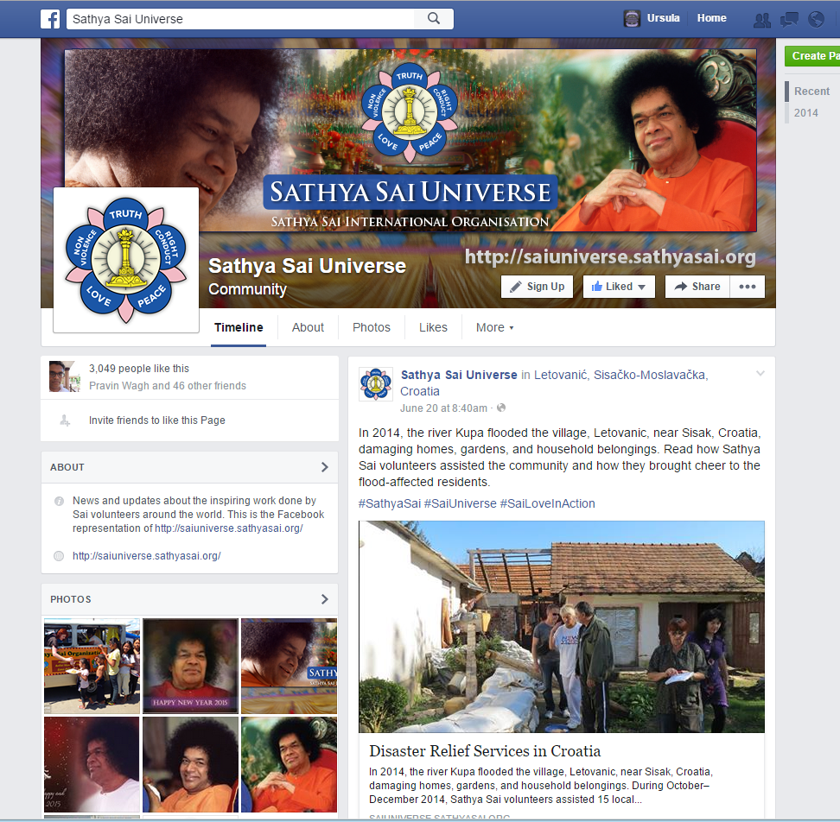
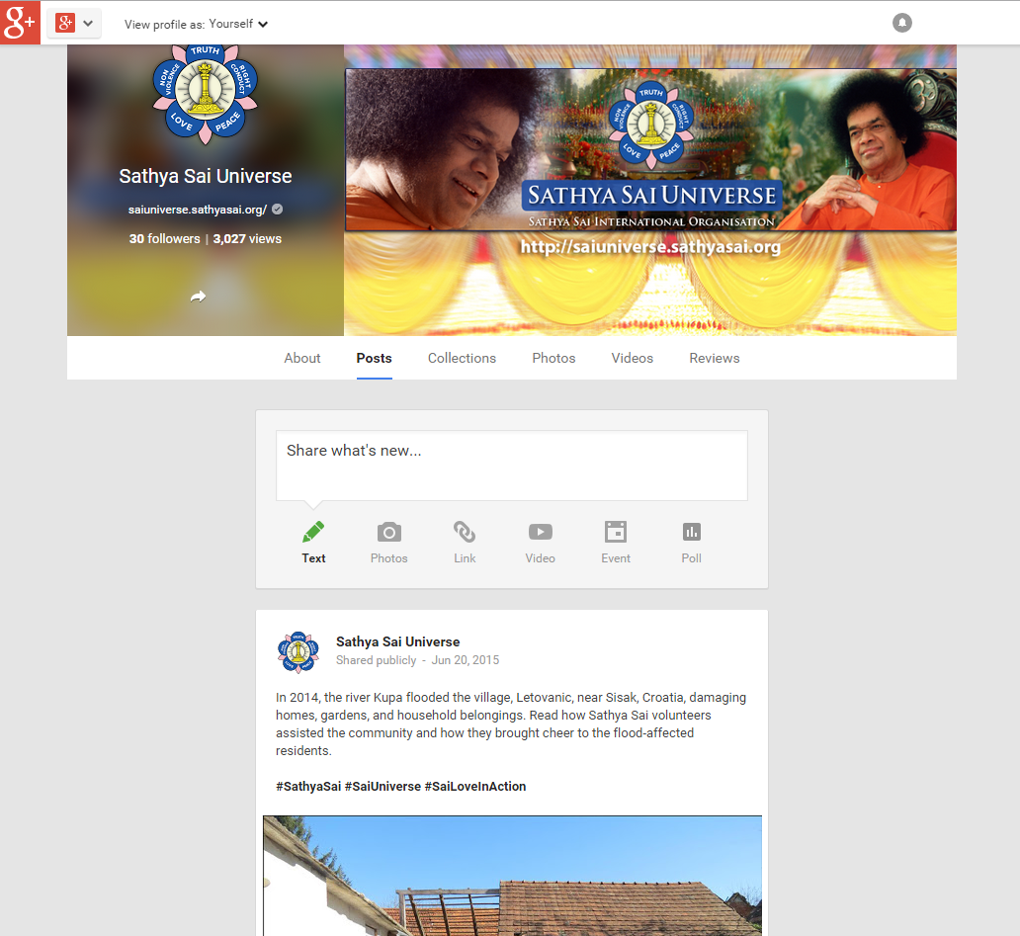
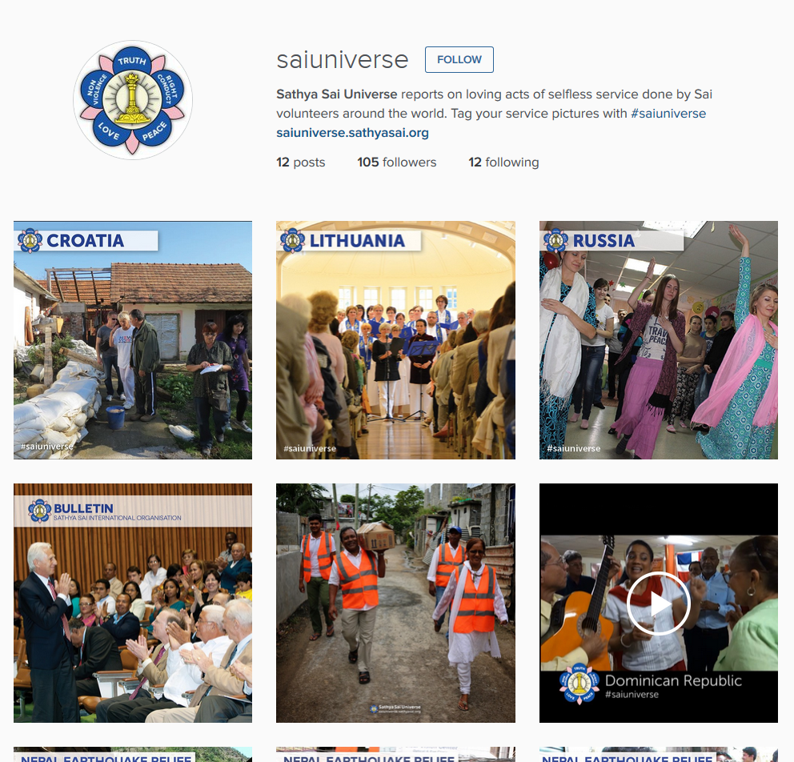
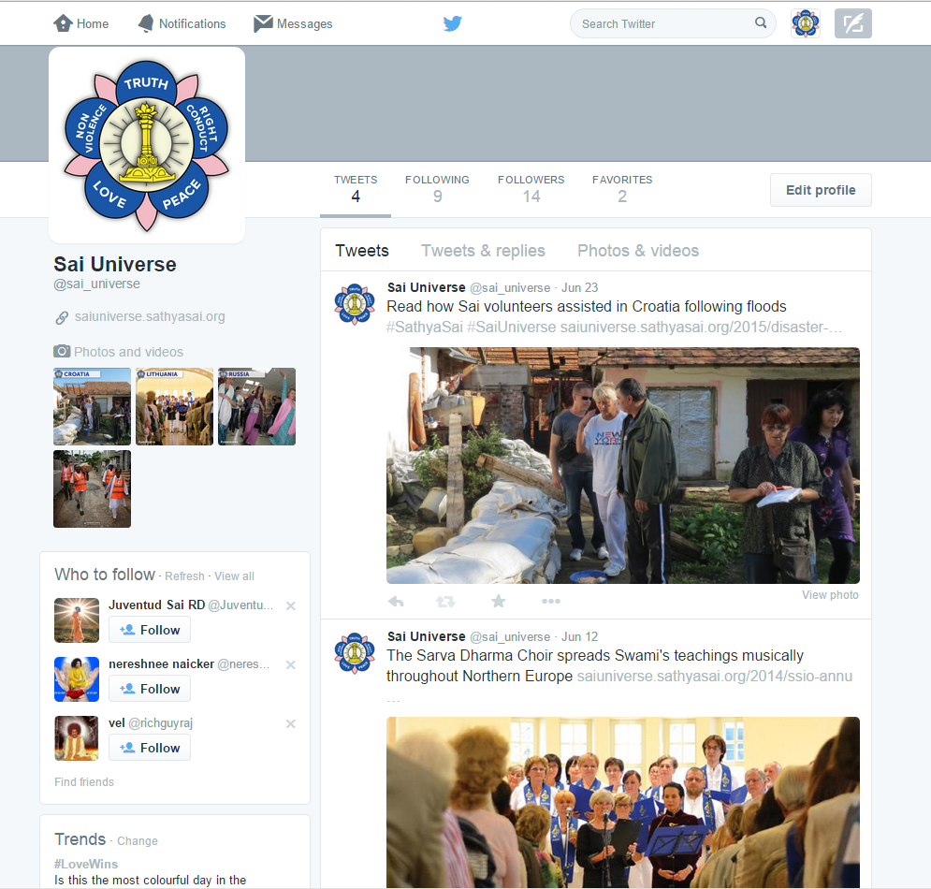
Social Media
Sathya Sai Universe is the main channel
Facebook
Instagram
Twitter
Bulletins
WhatsApp

Slide 2
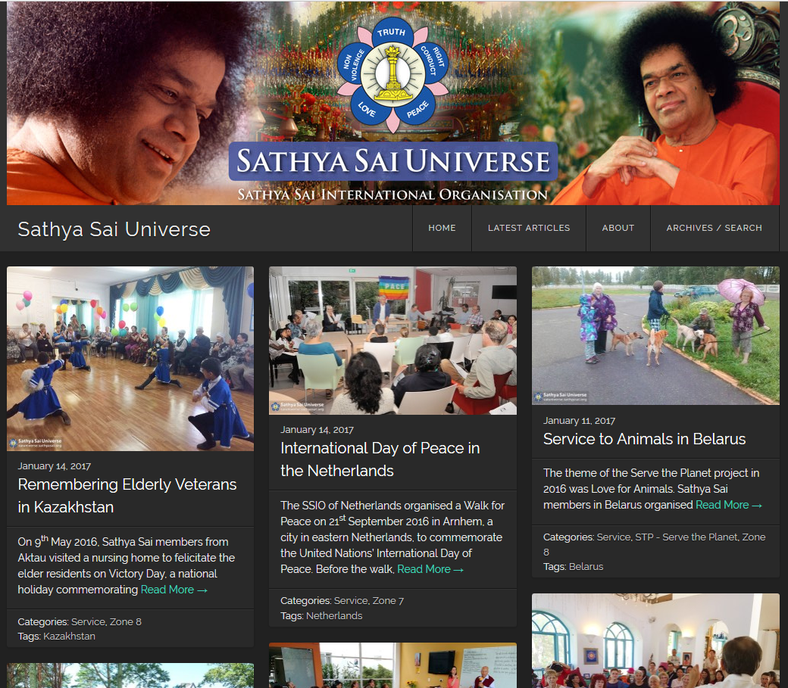
Sathya Sai Universe Website

Slide 3
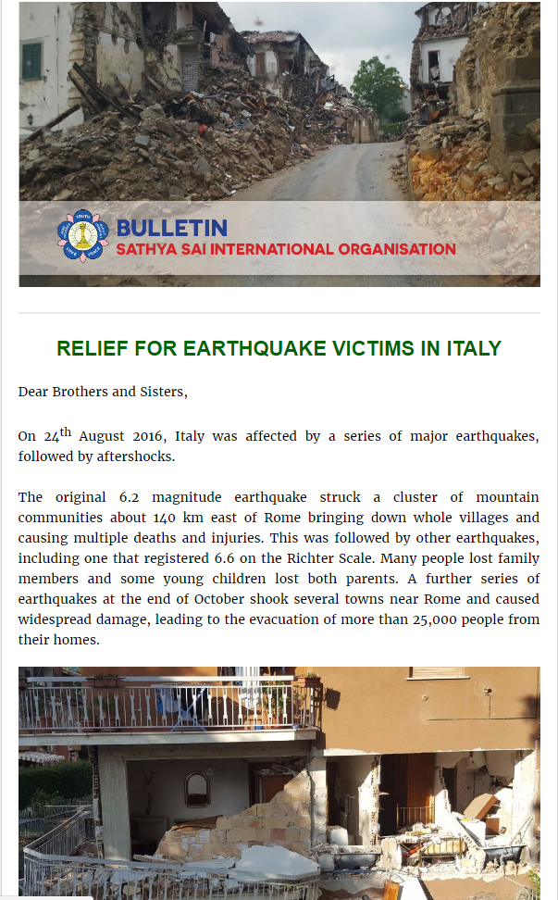
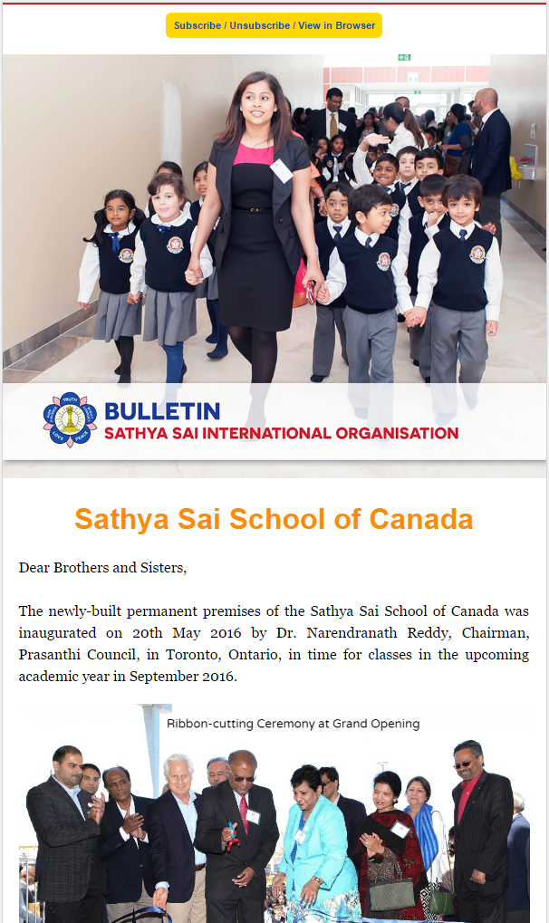
SSIO Bulletin

Slide 4
Social Media
Please follow us and spread the word about our social media accounts
Look for #saiuniverse
Please let us know about YOUR social media accounts, including contact information
We may contact your account directly

Slide 5
Help Us Increase Awareness
Please follow the SSIO pages/accounts on Facebook, Instagram, Twitter
On Facebook: Visit the page and click on the “Like” button

Slide 6
Help Us Increase Awareness
When you see a post that you like, please click the “Like” button at the bottom
Some of your friends will see that you liked it and they may also see the post

Slide 7
Help Us Increase Awareness
Sharing is the best way to spread the word about a post
Click the “Share” button to share on your own wall, to a group you belong to, or with friends

Slide 8
Social Media Guidelines
Guidelines and “best practices” for social media and websites coming soon
Advice for now:
Focus your content on Swami’s direct teachings and Organizational news
Do not share miscellaneous inspirational quotes or get involved with sharing of social or political issues
Liking/resharing implies endorsement, limit yourself to staying within Sai topics

