Slide 1
Sri Sathya Sai Service Organisation (UK) Zone 9A
Report of Activities
January – June 2014

Slide 2
Organisation Map
Region 1: London South
Region 2: London North West
Region 3: London North East and East Anglia
Region 4: The Midlands
Region 5: Northern England
Region 6: Southern England
Region 7: South West England and Wales
Region 8: Scotland

Slide 3
General
50 centres
42 groups
Regular attendees – over 5000
540 SSE Classes held last 6 months
1100 SSE pupils managed by 260 SSE Gurus
Regular activities: devotional singing, study circles, interfaith participation, homeless shelters, food distribution, SSE classes, Health Awareness Clinics, blood donation etc

Slide 4
Theme for 2014
UK designated theme for the year ‘One with Sai’.
All activities focussed around this

Slide 5
National Activities
‘Sai Smaran’ – 6 hours of continual high quality devotional singing led by youth involving participation by all centres in regions. Around 300 devotees attend. Helped devotees come together. Video link provided for devotees at home to join as well.
Held 2 events:
11th January (Watford, London)
31st May (Toothing, London)

Slide 6
National Activities
14th January – new Council announced; new Office Bearers taking regional / centre, group positions
National Sathya Sai Orientation Conference
Annual event – held 25th January.
Theme: ‘One with Sai, His Words & His Work’
Attended by about 300 – Office Bearers and Active Members
Positive impact, battery re-charge, got broader awareness of the Mission and message of Sathya Sai

Slide 7
National Sathya Sai Orientation Conference, Hatfield, London

Slide 8
National Activities
National Wing Meeting held on 9th March
Objective was to reinforce the theme ‘One with Sai, His Work & His Words’
understanding that transformation of our hearts, through following His Teachings (His Words) and participating in the activities of the Organisation (His Work), is the only way to experience the bliss of Oneness
Agreed plans of the wings
Attended by 120 coordinators from around UK at national, regional and centre / group levels

Slide 9
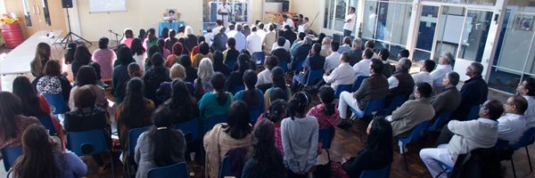
National Wing meetings

Slide 10
National Activities
Sathya Sai National Human Values Day (SSNHVD) celebrations held on 26th April to commemorate the Mahasamadhi of our Dear Lord
Theme: ‘God is Love, Live in Love’
Venue: Watford Colosseum, London
600 devotees participated
Representation by 9 different religions who presented prayers, songs and music as offering
Generated lot of enthusiasm and joy and understanding of the Divine Message

Slide 11
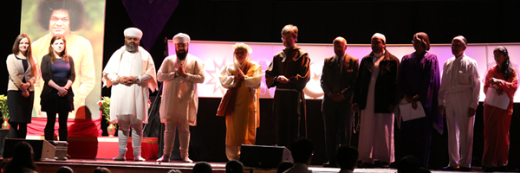
SSNHVD 26April14

Slide 12
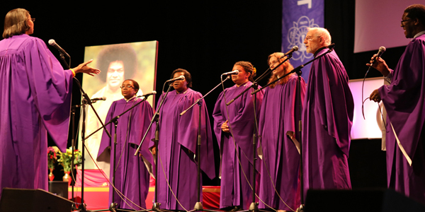
SSNHVD

Slide 13
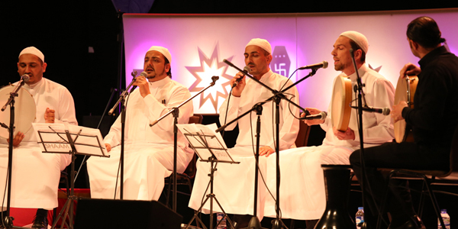
SSNHVD

Slide 14
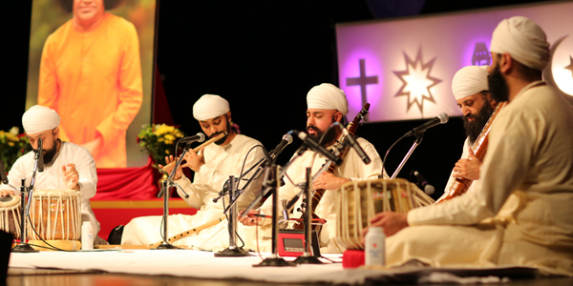
SSNHVD

Slide 15
National Activities
National Easwaramma Day Celebrated on the 3rd May in Hatfield, London
Theme: ‘Walk with Sai & Be One’
Attended by 500 – adults and children
offerings of prayer, music, song, drama, dance and talks, children and adults

Slide 16
National Easwaramma Day Celebrations

Slide 17
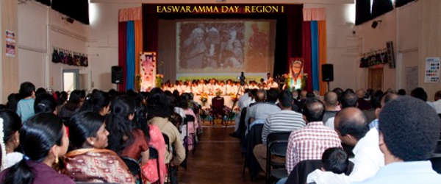
Region 1 – Regional Easwaramma Day Celebrations

Slide 18
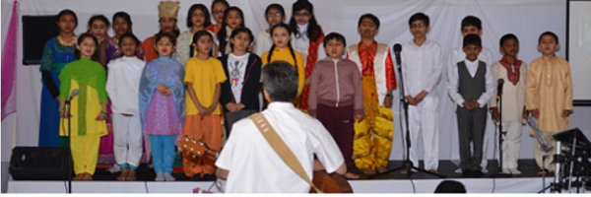
Easwaramma Day – Toothing Centre

Slide 19
National Activities
National Pilgrimage – 27th July to 2nd August.
Theme: ‘Sai Samarpanam – One with Sai’
Registration opened
40 devotees registered
Sadhana Meetings in preparation held so far:
18th May
14th June

Slide 20
National Activities
Flood Relief efforts in the UK
Devotees from around the country rallied and offered donation of essential items
3 deliveries were made to affected areas
Sathya Sai Emergency Relief Committee established to deal with future disasters in UK

Slide 21
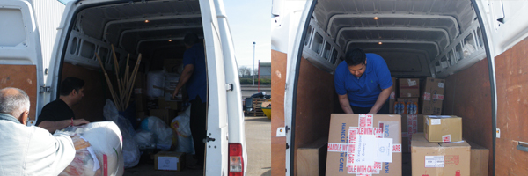
Delivery of Items to Flood Areas

Slide 22
National Activities - Other
Strengthening Infrastructure for the Organisation
SITA (Sathya Sai Information Technology & Arts) Team meeting held 16Feb14
Reports to Service Wing
Objective was to bring core team together and raise awareness of the Sathya Sai Mission and our roles
IT and Communications Division- Web Team (programmers, content support); Public Relations Team (media, legal, event management, hospitality).
Publications Division- Graphic Designers, Proof Readers, Journalists, Writers
Audio-visual Division- Sound Team, Live Vision Team, Photography Team, Lighting Team, Post-Production Team, Web Stream.
Archiving Division

Slide 23
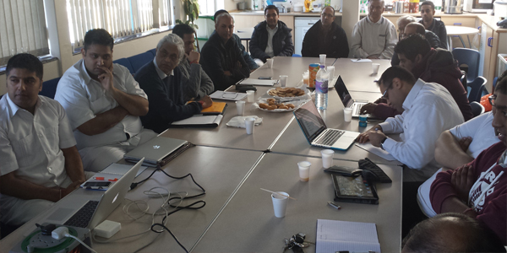
SITA Team Meeting

Slide 24
National Activities - Other
Strengthening Infrastructure for the Organisation (continued)
SSLTP (Sathya Sai Leadership Training Programme) Steering Team established
Objective to review existing programme to ensure it is aligned to developing leadership at all levels of the organisation
Meetings held 18 May & 14 June

Slide 25
Regional Activities
Regional Sathya Sai Orientation Conferences attended by Office Bearers and Active Workers on 16th March.
Theme: ‘One with Sai, His Words & His Work’
Region 4 (Leicester) – 65 attendees
Region 5 (Bradford) – 20 attendees

Slide 26
Regional Activities
SSE Basic Training and Awareness
Provided in different regions for SSE teachers, both new and current, helpers, parents and Office Bearers
Region 6 – 1st March - Farnborough
Region 3 – 22nd March – Manor Park
Region 2 – 24th May - Watford

Slide 27
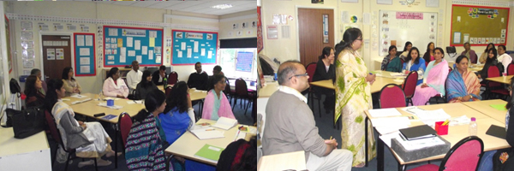
SSE Training

Slide 28
Regional Activities
Youth had monthly YAP (Young Adults Programme) in different regions
Brings youth of region together
Discussion in study circles, doing service etc
Youth actively participated in national, regional and centre activities and the wings

Slide 29
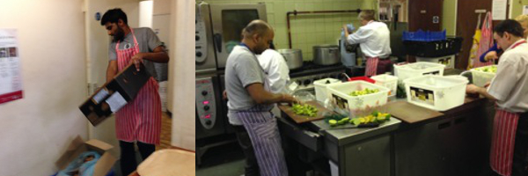
Regional Activities
Youth helping Homeless Shelter

Slide 30
Centre Activities
Most centres celebrated the major celebrations –
Mahasamadhi Day – 24th April
Easwaramma Day
Maha Sivarathri – 28th February
Rama navami
Buddha jayanthi – in May

Slide 31
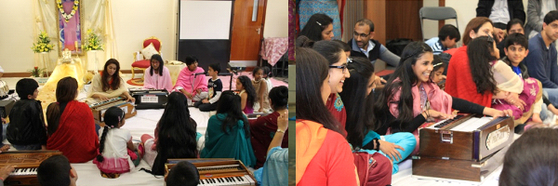
Bhajan Workshop

Slide 32
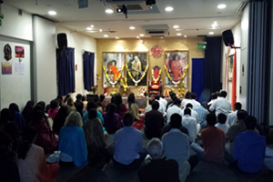
Sivarathri Celebrations

Slide 33
Centre Activities
On Service, lot of centres were involved in either homeless shelters, meals on wheels, providing food items to local food banks etc
Some centres also involved in Health Awareness Clinics e.g. Toothing centre hosted workshops on ‘Heart Disease Prevention’ attended by 38 people

Slide 34
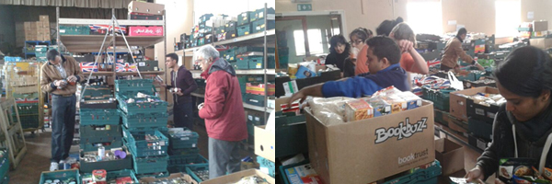
Food Bank Service at Coventry Centre (Region 4)

Slide 35
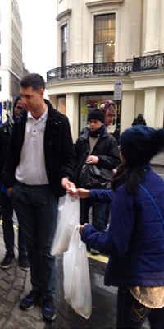
Serving Homeless Shelter in Region 3

Slide 36
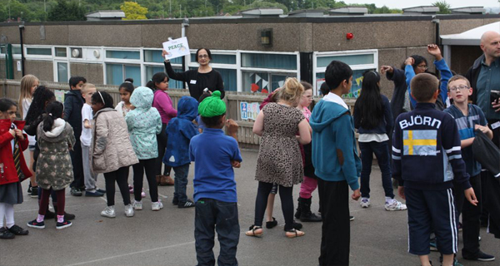
Stokes Wood Good Values Club Event (SSEHV) 26- 30 May 2014
Organised in Leicester by ISSE
50 children from 2 schools participated – many from deprived areas

Slide 37
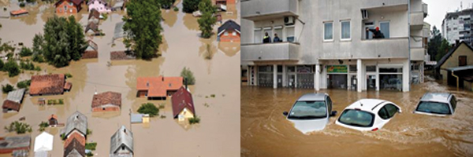
Devastation in Balkans
Sathya Sai Charitable Trust (UK) has pledged £10,000 towards the appeal and coordinating efforts with the local Sai Organisation

Slide 38
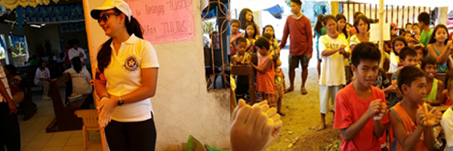
Few Medical Personal from UK helped aid efforts in the Philippines Disaster

