Slide 1
Zone 4 Report December 2013 – June 2014
Sri Sathya Sai Countries of Zone 4

Slide 2
Indonesia

Slide 3
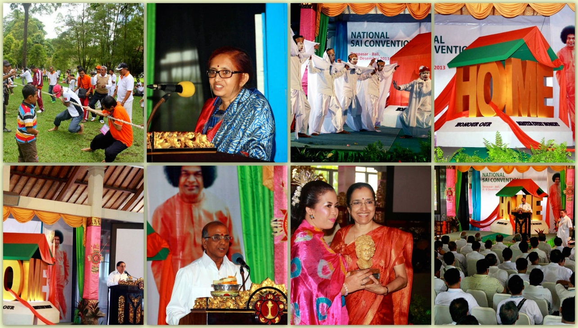
National Sai & Youth Convention
Denpasar, Bali (6th - 8th December 2013)
Prof. R. Gangadhara Sastry and Prof. Rajeshwari C Patel from Sri Sathya Sai Institute of Higher Learning, Prasanthi Nilayam & Ananthapur

Slide 4
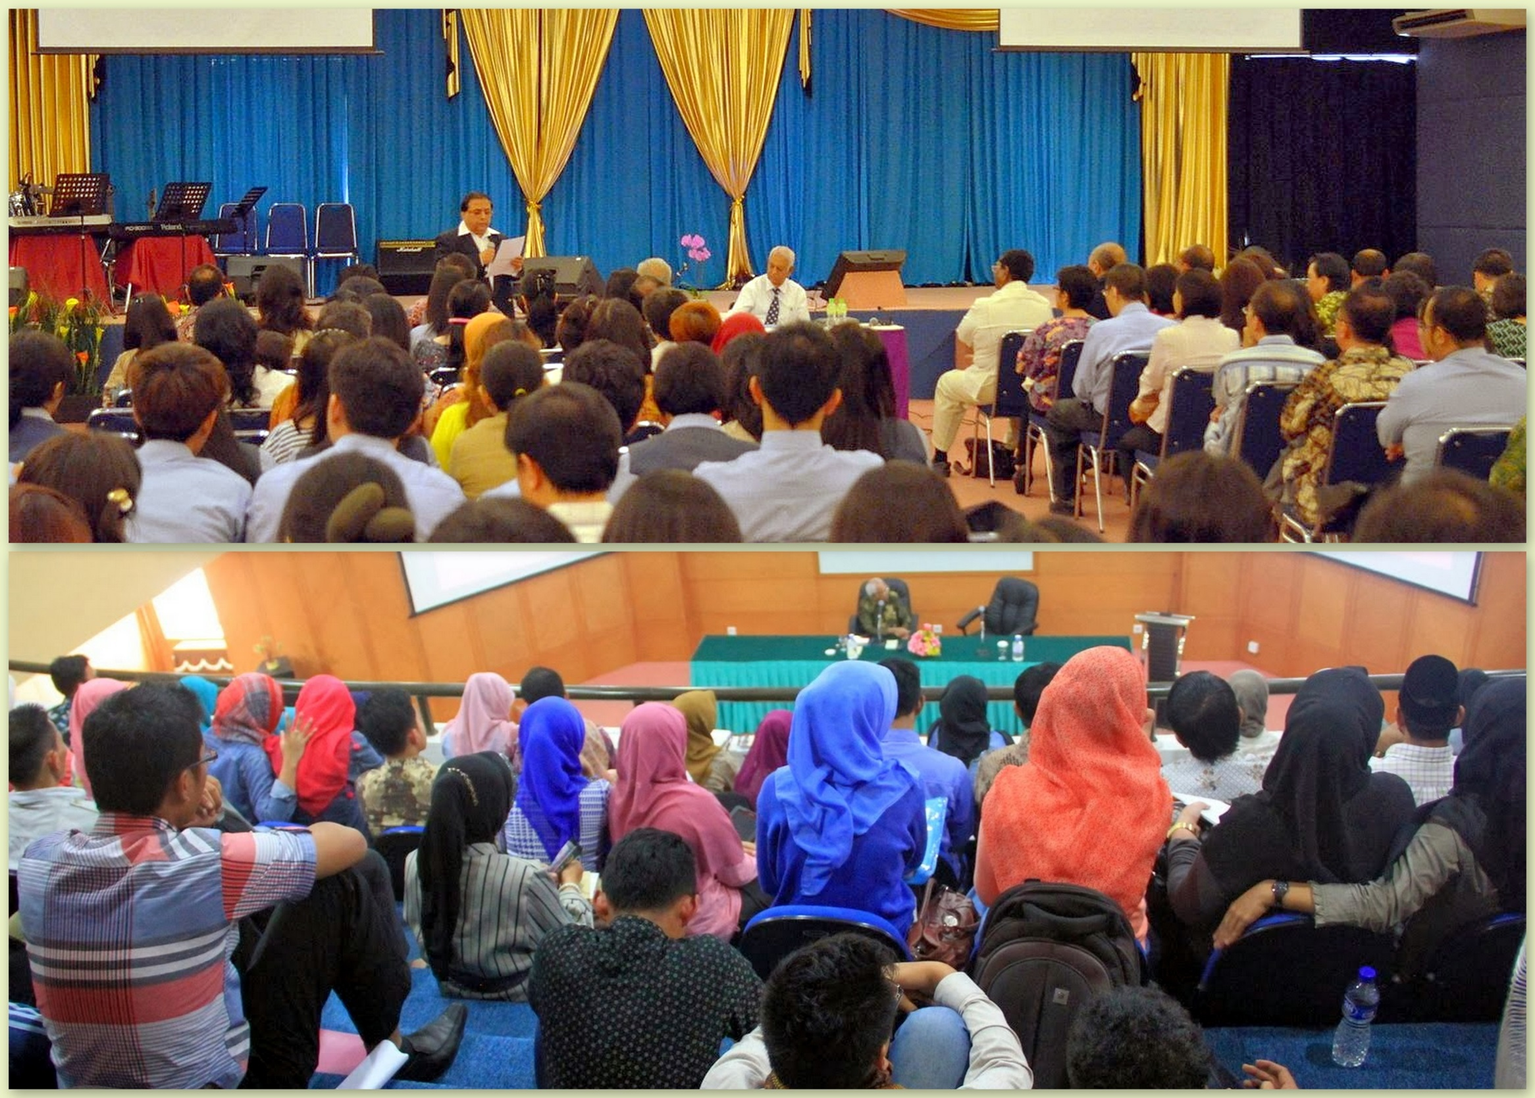

Slide 5
Search & Rescue Basic Training
Joint session between Indonesian Sai Council &
Sai Rescue Team of Bali (BASARNAS)
16th to 18th of May 2014
83 people participated in Workshop on basic search & rescue knowledge

Slide 6
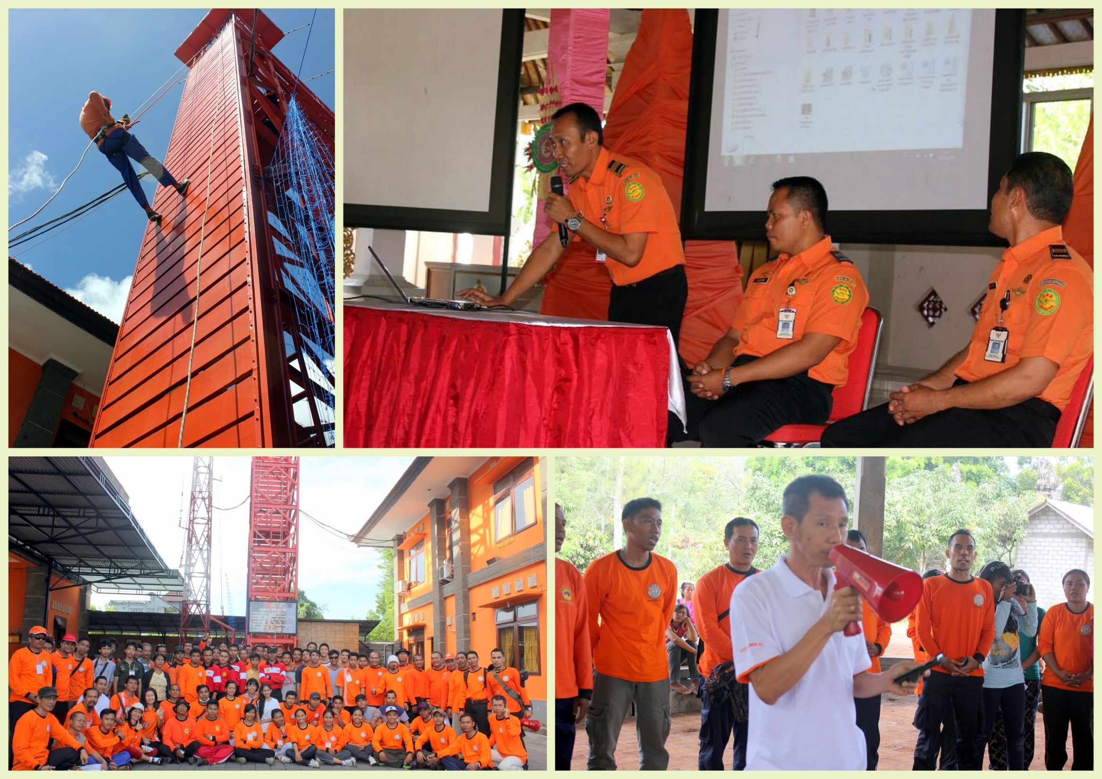

Slide 7
Mount Kelud Eruption
On the evening of 13th February 2014, Mount Kelud in East Java, Indonesia erupted
Devotees from Surabaya, East Java immediately began offering aid in Batu about 20km from worst hit area
On 21st February 2014, nine Sathya Sai volunteers distributed food and supplies to 1,500

Slide 8
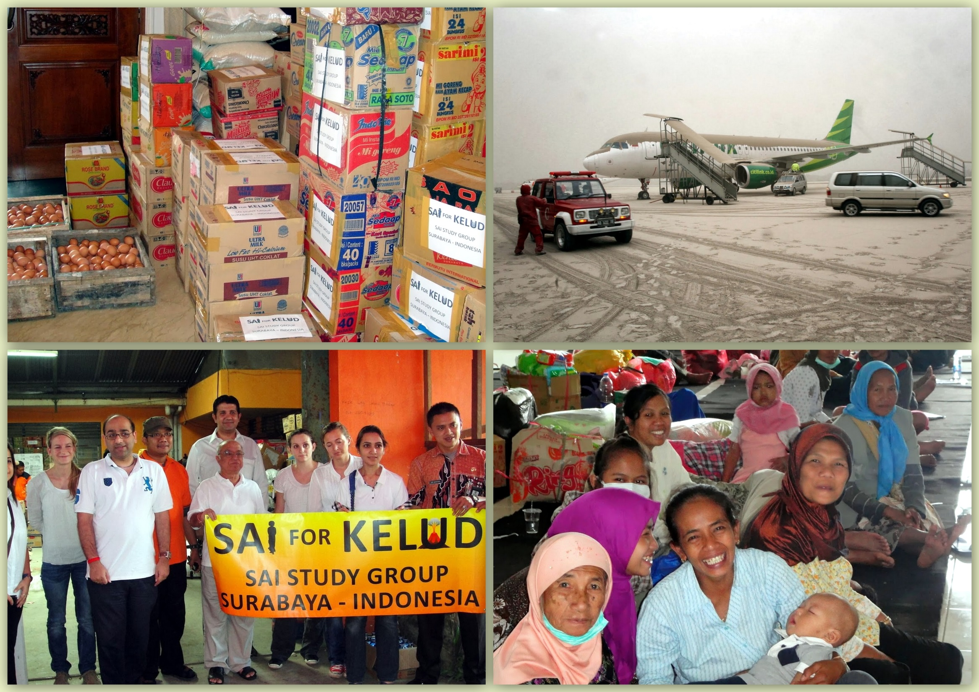

Slide 9
Malaysia

Slide 10
Unity Prayers by Friendship Group
Members of the Friendship Group visited the Sultan Zainal Abidin Mosque (Iron Mosque) in Putrajaya for prayers and meetings
A special prayer dedicated to the family and crew members of missing Flight MH370
First visit to a mosque by the Sai Group

Slide 11
Unity Prayer
FGIS Leaders inside the Iron Mosque, Putrajaya

Slide 12
Mahasamadhi Seva
National seva on 24th of April 2014
Total of 1,500 people were served lunch
Community Adoption Program was launched in Lereh, Melaka + Parents Appreciation Day
Medical screening

Slide 13
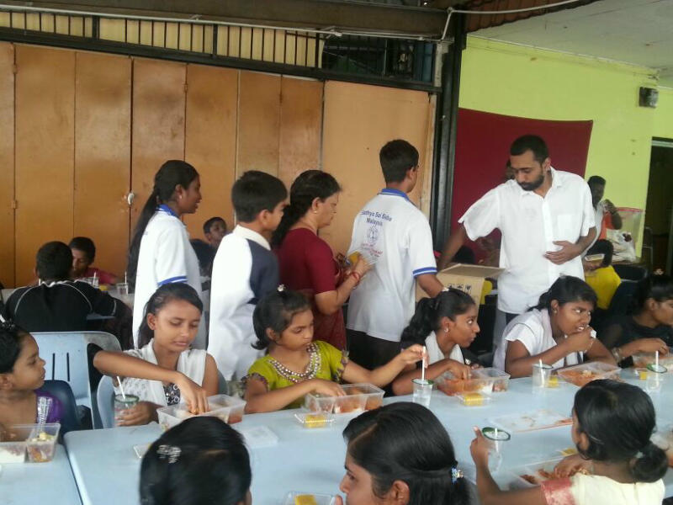
Narayana Seva
Food Program carried out by centres in Kuala Lumpur/Selangor

Slide 14
Parents Appreciation Day
Parents Appreciation Day (PAD) organised at Rumah Pangsa Lereh, Melaka.

Slide 15
Educare Conference
19 – 21 June 2014
Held at the Faculty of Education, University Malaya
Theme was “Education to Educare - Value based education in the new millennium”

Slide 16
Singapore

Slide 17
Mahasamadhi Seva Activities
Distribution of food for 400 migrant workers
Senior citizens dinner and entertainment for 150 seniors by Sai Kindergarten children
Food packing and distribution for 500 inmates at Institute of Mental Health
Study circle, video screening of Swami and live video talk by Bro Satyajit from India

Slide 18
Willing Hearts Seva
The Willing Hearts Project is a Soup Kitchen to serve needy families in Singapore
Volunteers help in preparing, packing and delivering food across the island
The Sai Youth Wing sevadals have joined in to help every fortnight

Slide 19
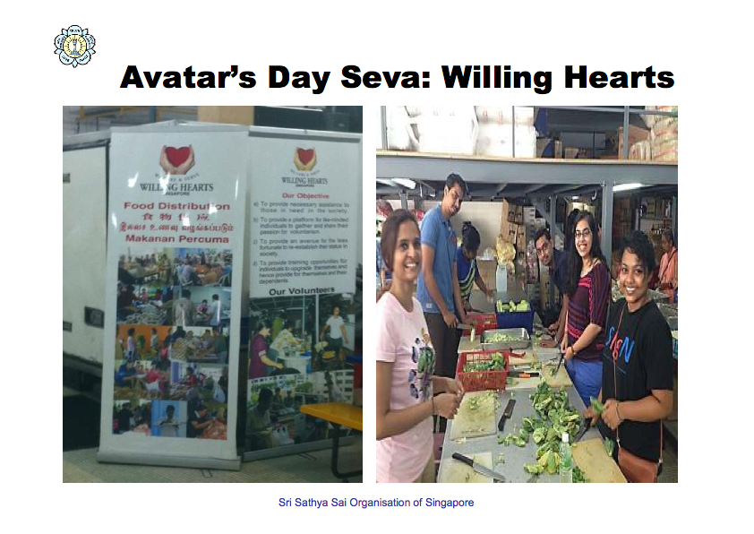

Slide 20
Thailand

Slide 21
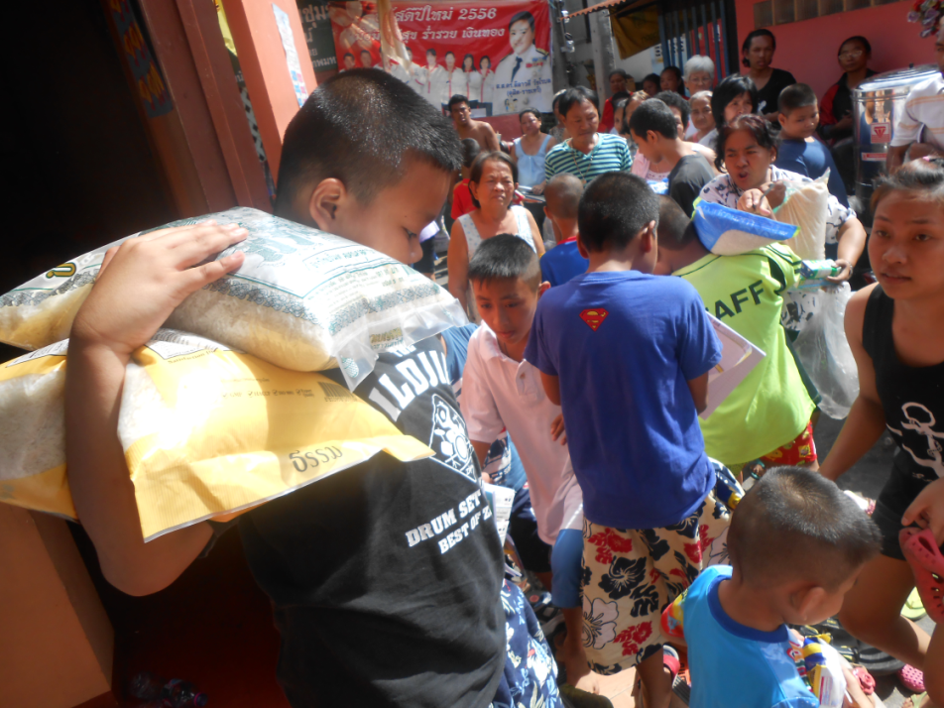
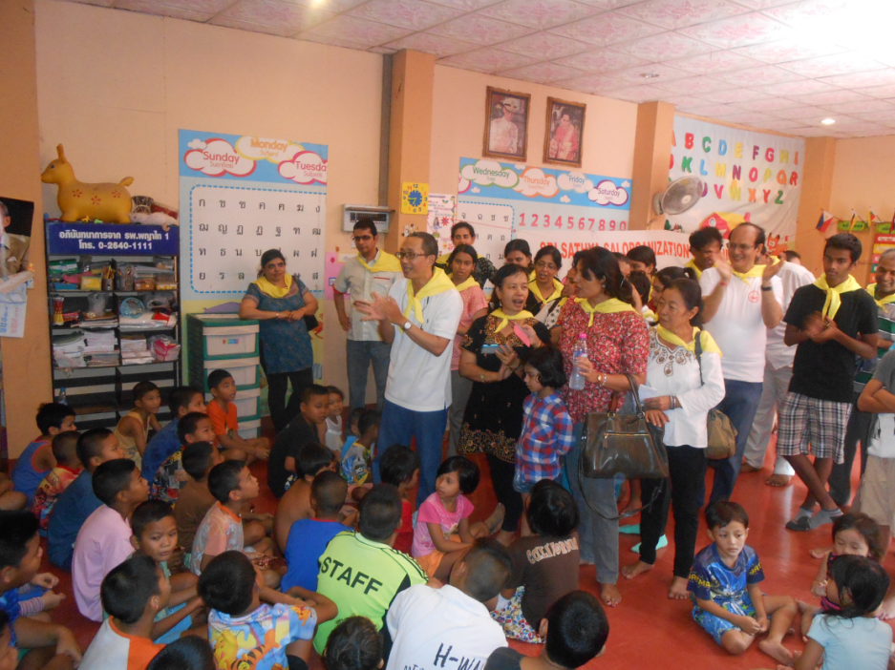
Narayana Seva
Seva in the Zarurat Community by devotees from Rajdamneon & Sai Prasanthi Center in Bangkok
Provided rice and snacks for 300 families which included over 100 children

Slide 22
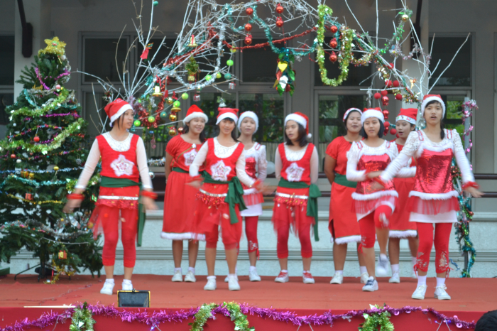
Christmas with Good Shepherd Sisters
Special bhajans were held at the chapel, served dinner to 100 inmates

Slide 23
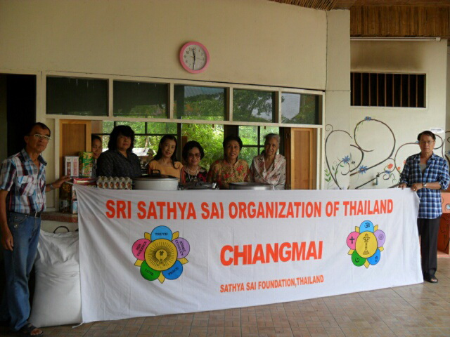
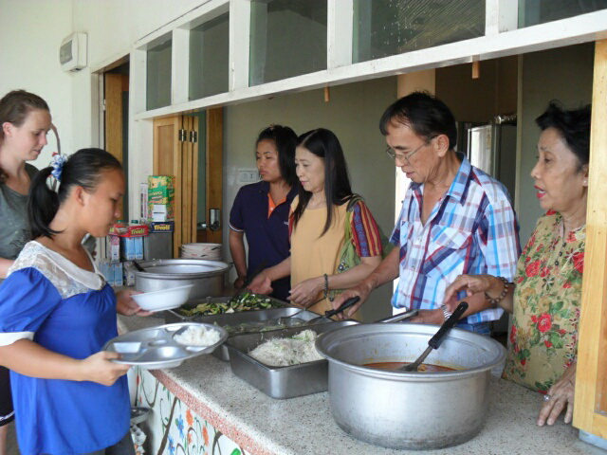
Mahasamadhi Seva
Devotees from Chiangmai served food and necessities to 13 children and 25 adults in an orphanage

Slide 24
Nepal

Slide 25
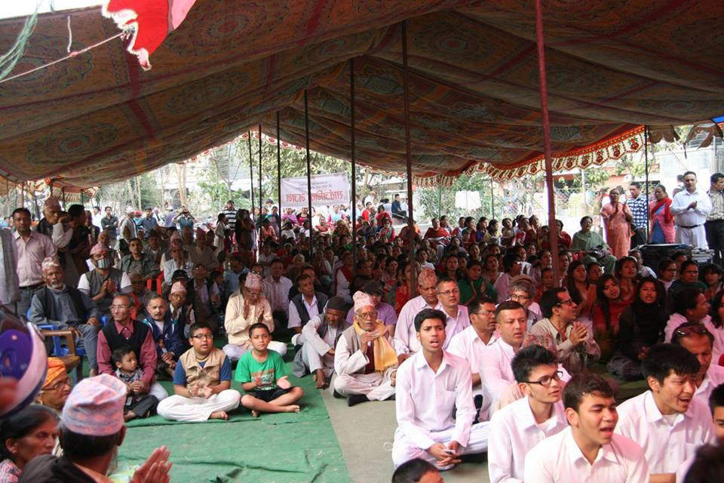
Community Bhajans
Nearly 6,000 people participated in Rama Navami celebrations – 69 locations

Slide 26
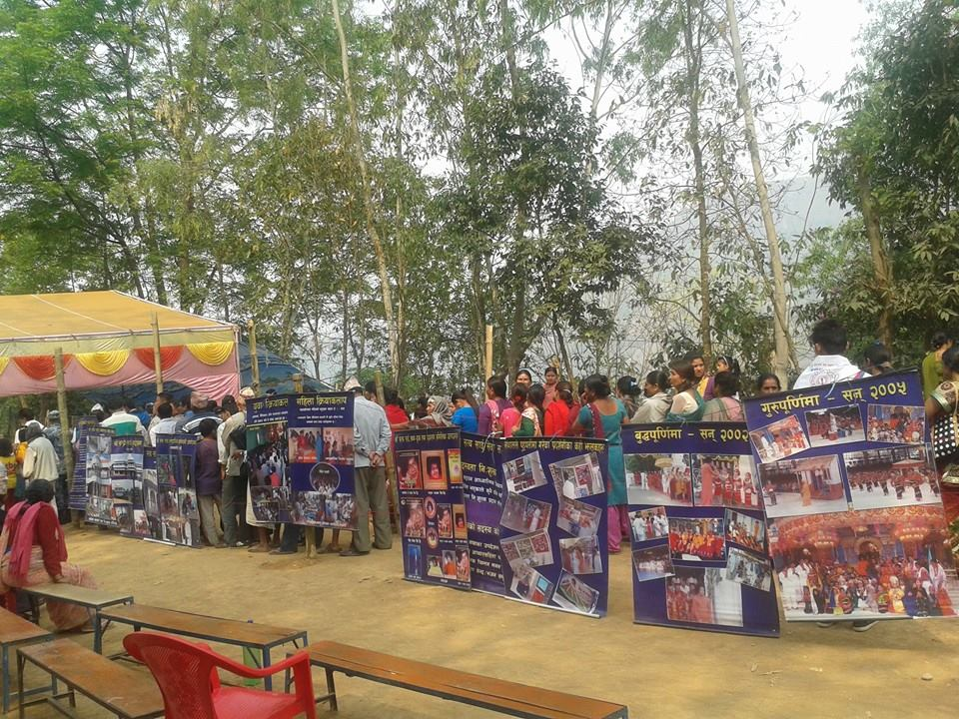
Public Meetings and Exhibition
Nearly 1,400 people attended 9 meetings

Slide 27
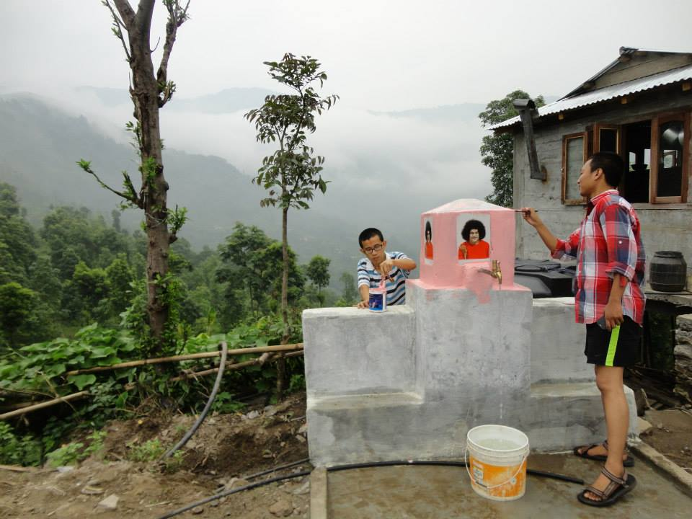
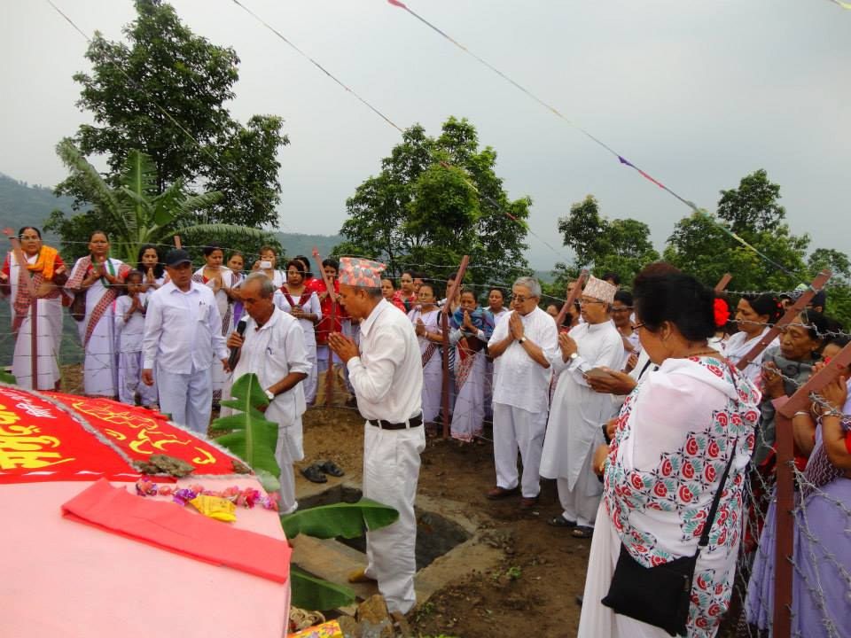
Community Drinking Water Project
Constructed in Iraunter in Eastern Nepal, serving 335 families, inaugurated on 7 June 2014
12,000 m of pipes built using1,214 man-days

Slide 28
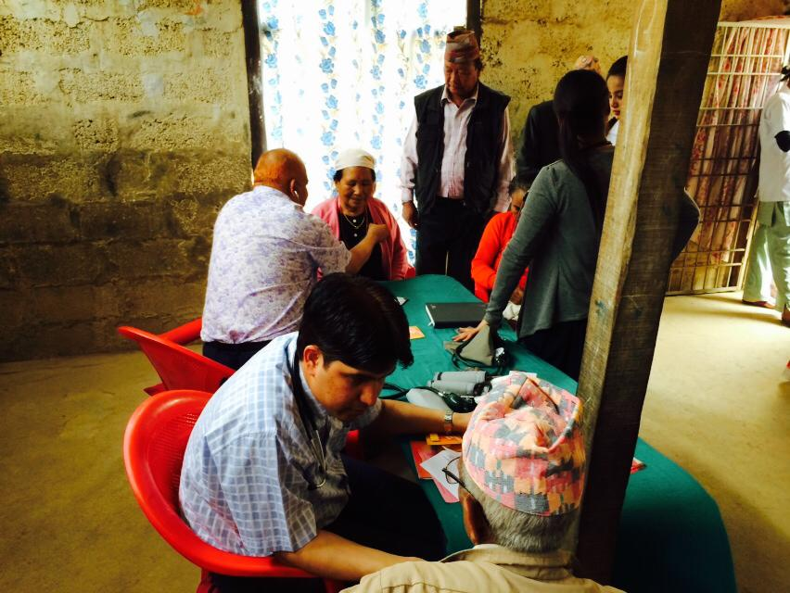
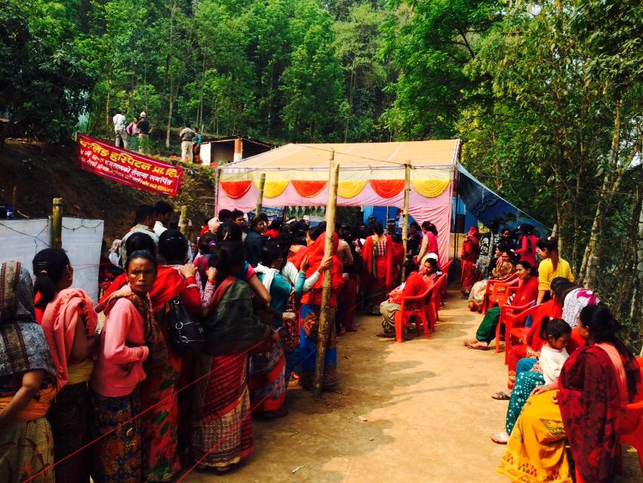
Medical & Eye Camps
Over 5,500 patients seen by 24 doctors and 37 nurses
Over 500 ladies seen at Special Medical camp
37 Blind children seen at Special Eye camp
Special 6 day homeopathic camp for 150 patients

Slide 29
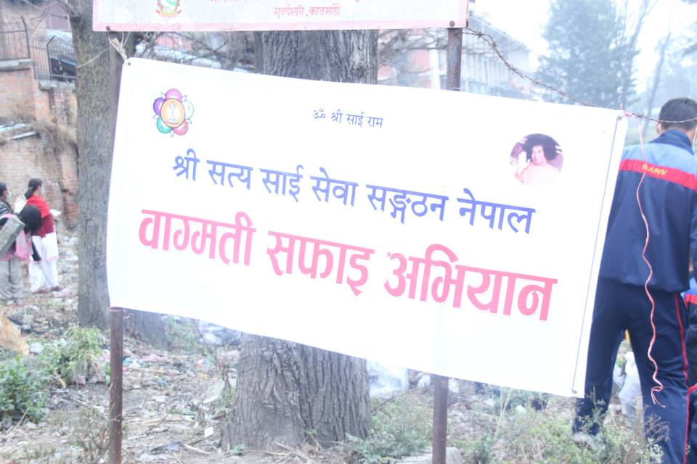
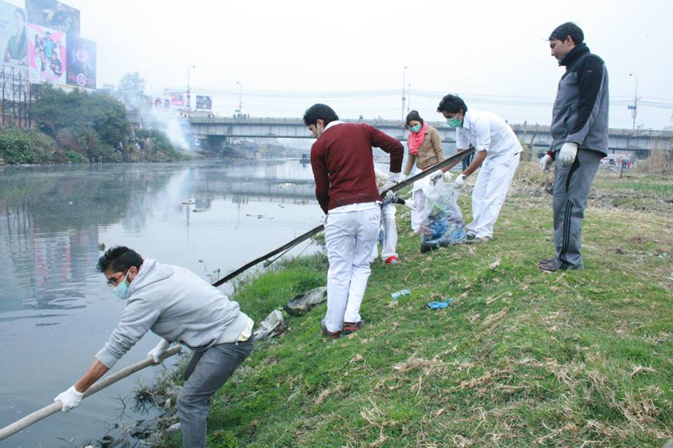
Bagmati River Cleaning Campaign
Project was initiated by the Chief Secretary of the Government of Nepal
Involved 100 volunteers from the Nepalese Sai Organization

Slide 30
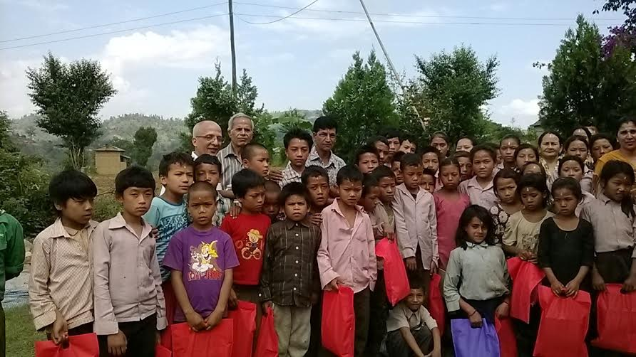
Sri Sathya Sai Scholarship Program
School uniforms, stationaries & school bags distributed to over 4,100 underprivileged children

Slide 31
Laos

Slide 32
Current Education Programme
Daily SSEHV classes
250 children and young adults divided into 8 classes
Won several government recognitions and awards
(Photo: Some of the children during New Year Celebration 2014)

Slide 33
Sathya Sai School in Laos
Blessed by Swami on Guru Poornima Day on 2010
Permission granted by the Government on November 2013
Ground breaking ceremony on November 23, 2013
(Photo: Ground breaking ceremony: 23 Nov 2013)

Slide 34
Photo of on-going school construction

Slide 35
Cambodia

Slide 36
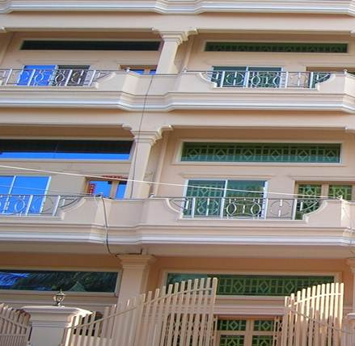
CAMBODIA SAI CENTER
Distribution of stationaries and books to orphans in Phnom Penh
Led Zone 4 Grama Seva team in Siem Reap
Planned ongoing visits to develop Sai Center, starting with EHV classes

Slide 37
Sri Lanka

Slide 38
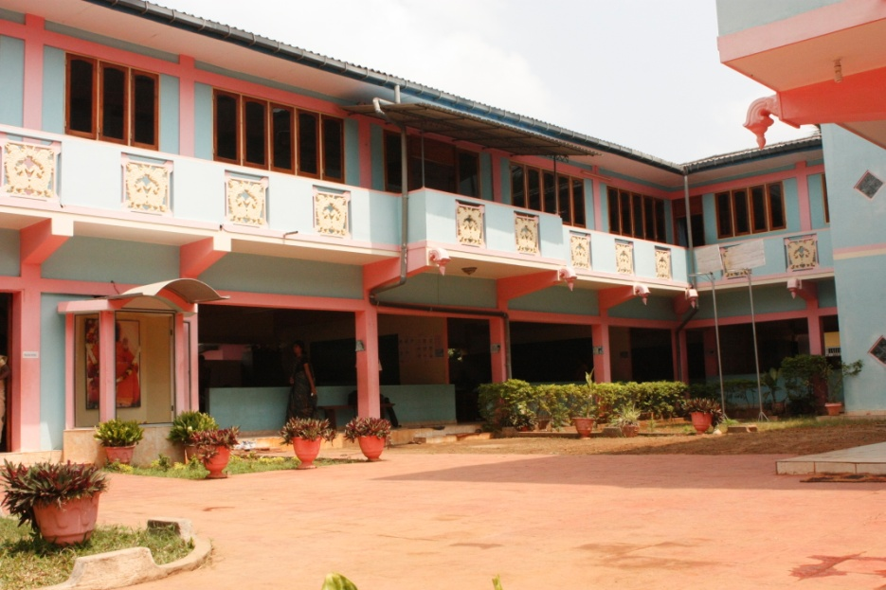
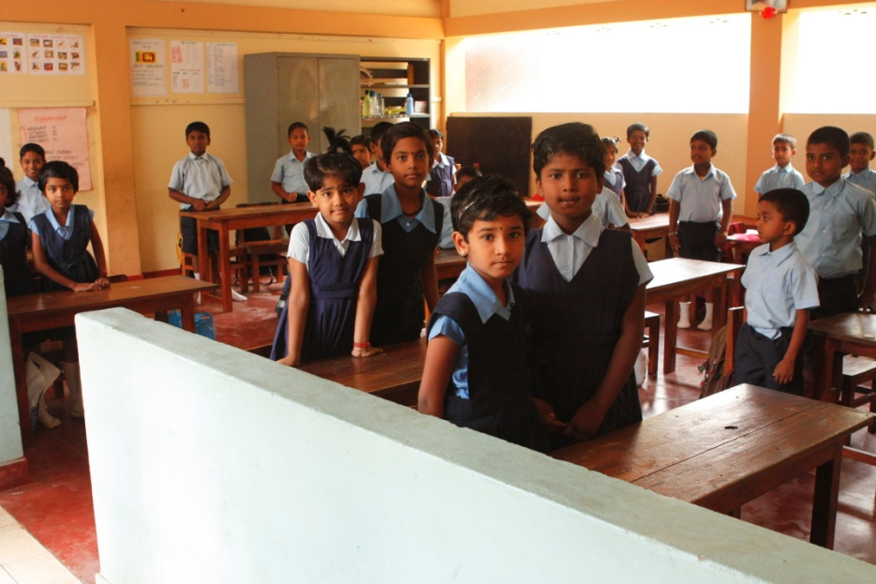
Sathya Sai School, Manipay, Jaffna
Full–time, independent, private school
Currently has Pre-school to Grade 11 with 187 students and 19 teachers

Slide 39
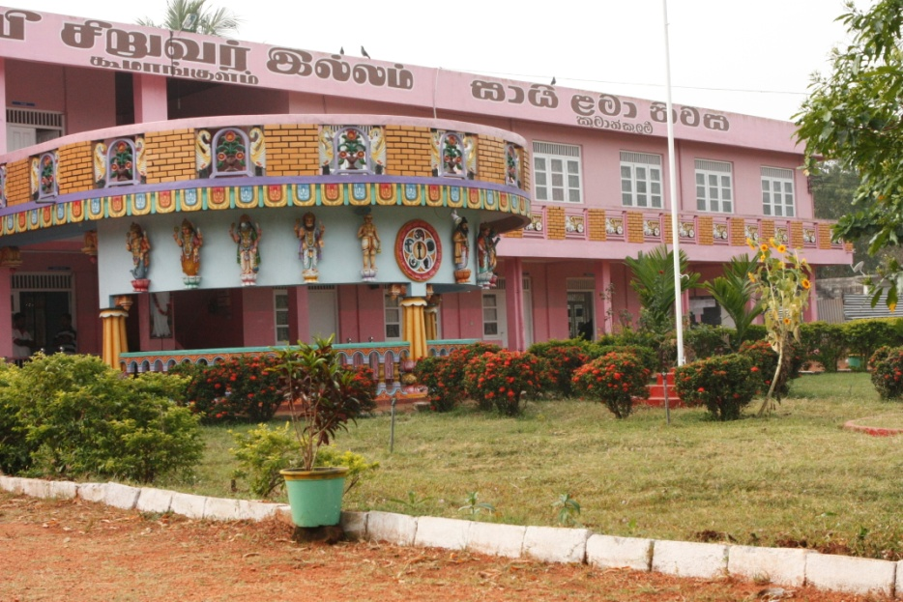
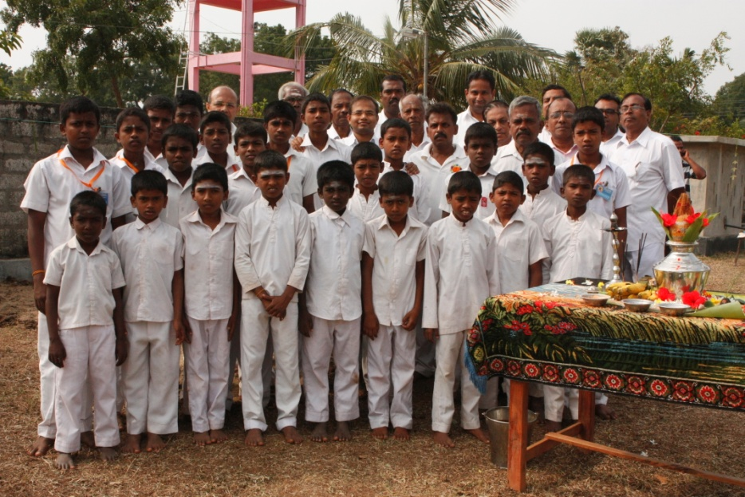
Sai Children's Home Vavuniya
Located in the village of Koomankulam – 28 underprivileged students

Slide 40
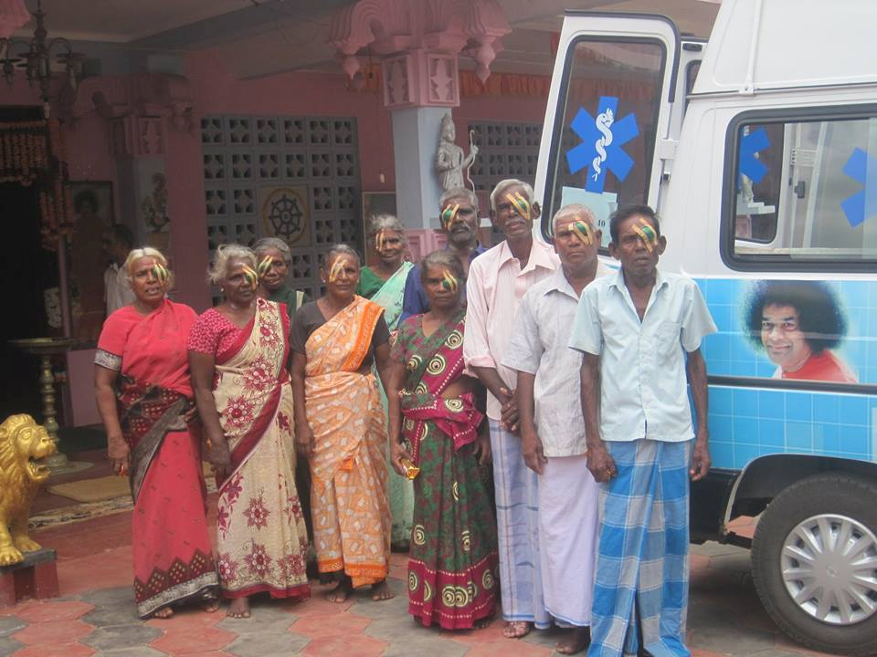
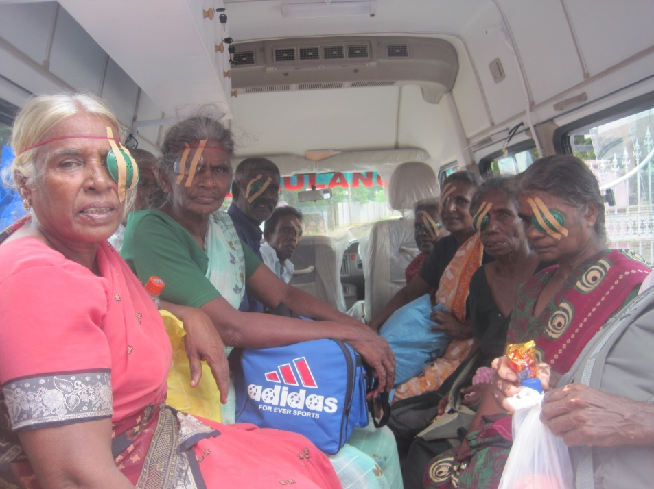
Ambulance for Medical Camps
Ambulance for medical camps in the North Central Region

Slide 41
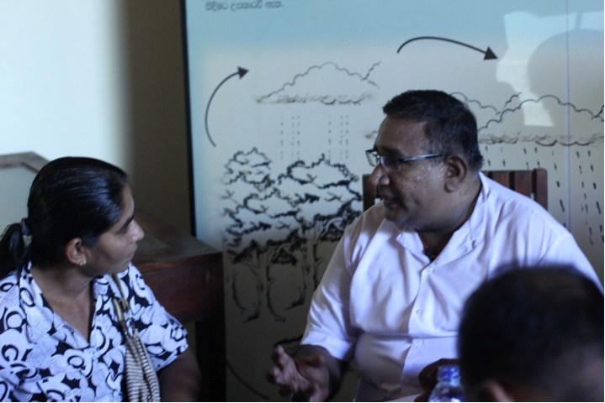
Medical Camps
Mobile Medical Camp on 1st June 2014
Medical camp in Saratha Vidyalayam on 24th April 2014
Beneficiaries Receive
General medicine, surgical problems and others: 640
Eye related problems: 172
Patients selected for cataract surgery: 14
Dental patients: 60

Slide 42
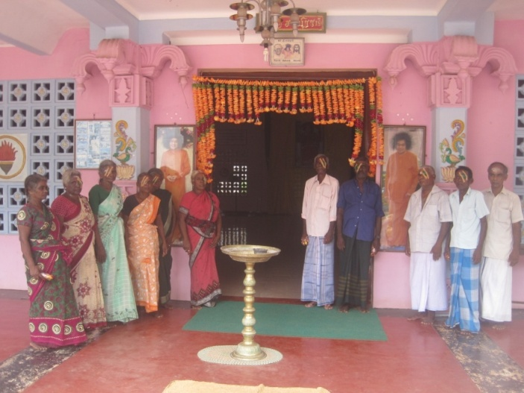
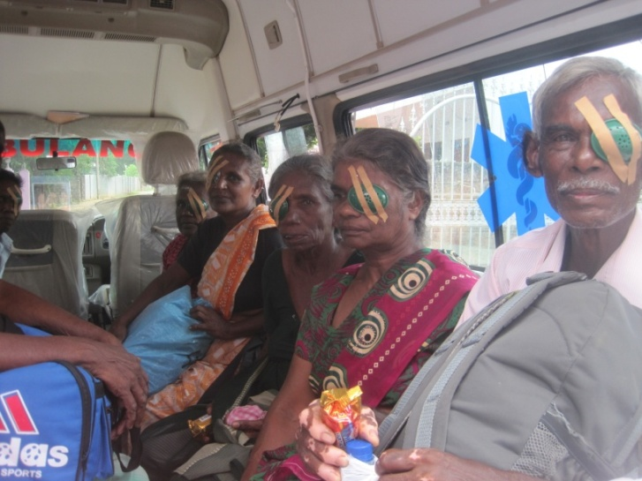
Eye camp and Cataract Surgery
Eye camp on 1st May 2014 at Alavanthankulam - 109 people received glasses
Cataract surgery for 10 patients at Jaffna Teaching Hospital

Slide 43
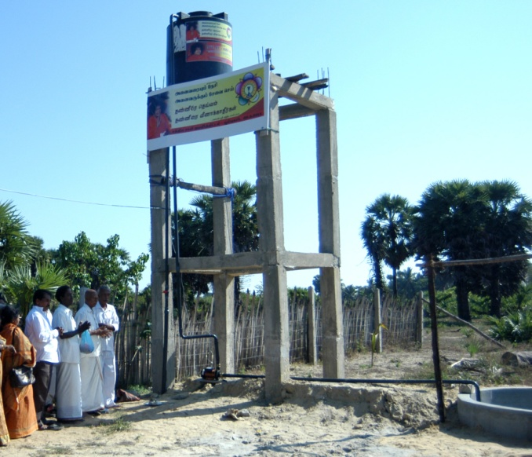
Sathya Sai Water project
Sathya Sai water project inaugurated at Poompukar village on March 29, 2014
Drinking water for more than 180 families

Slide 44
Village Development
Ayurvedic medical camp
Dental medical camp,
Health education
Providing LOVE pack-dry rations
Tree planting
Nutrition project

Slide 45
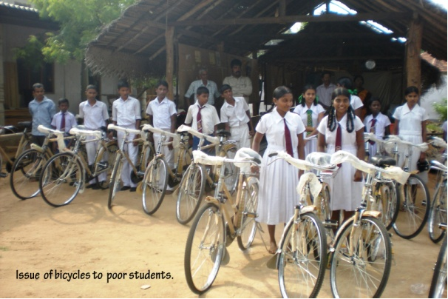
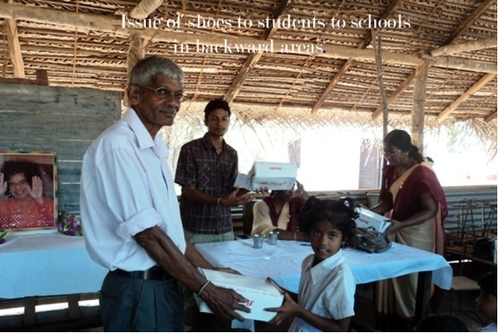
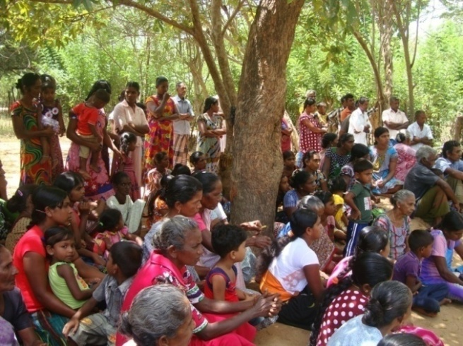
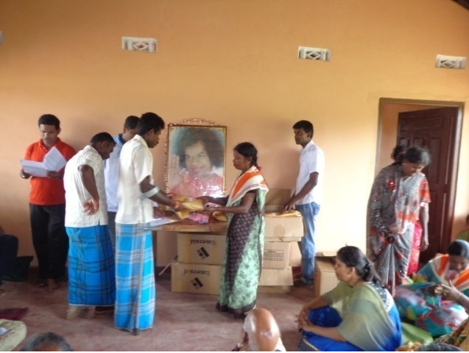
Village Development

Slide 46
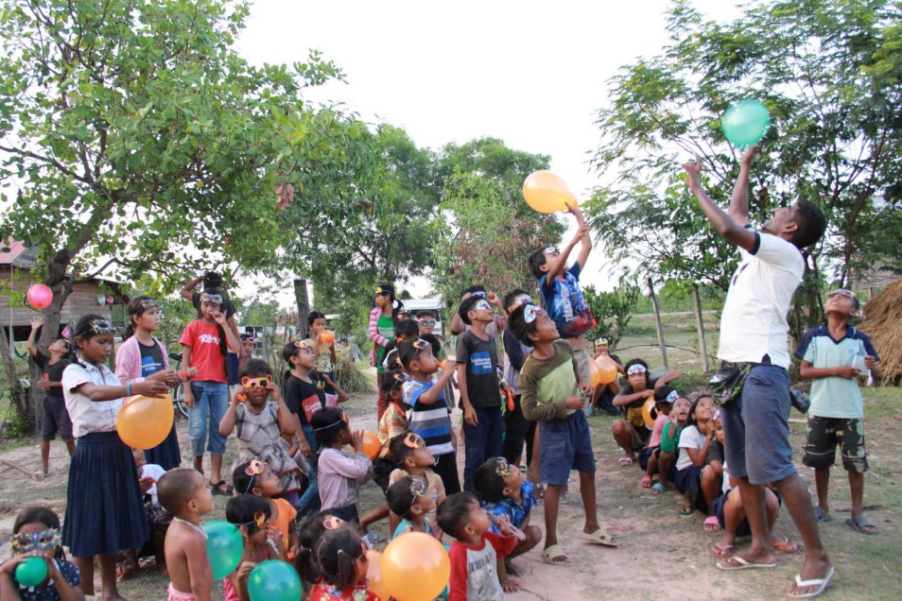
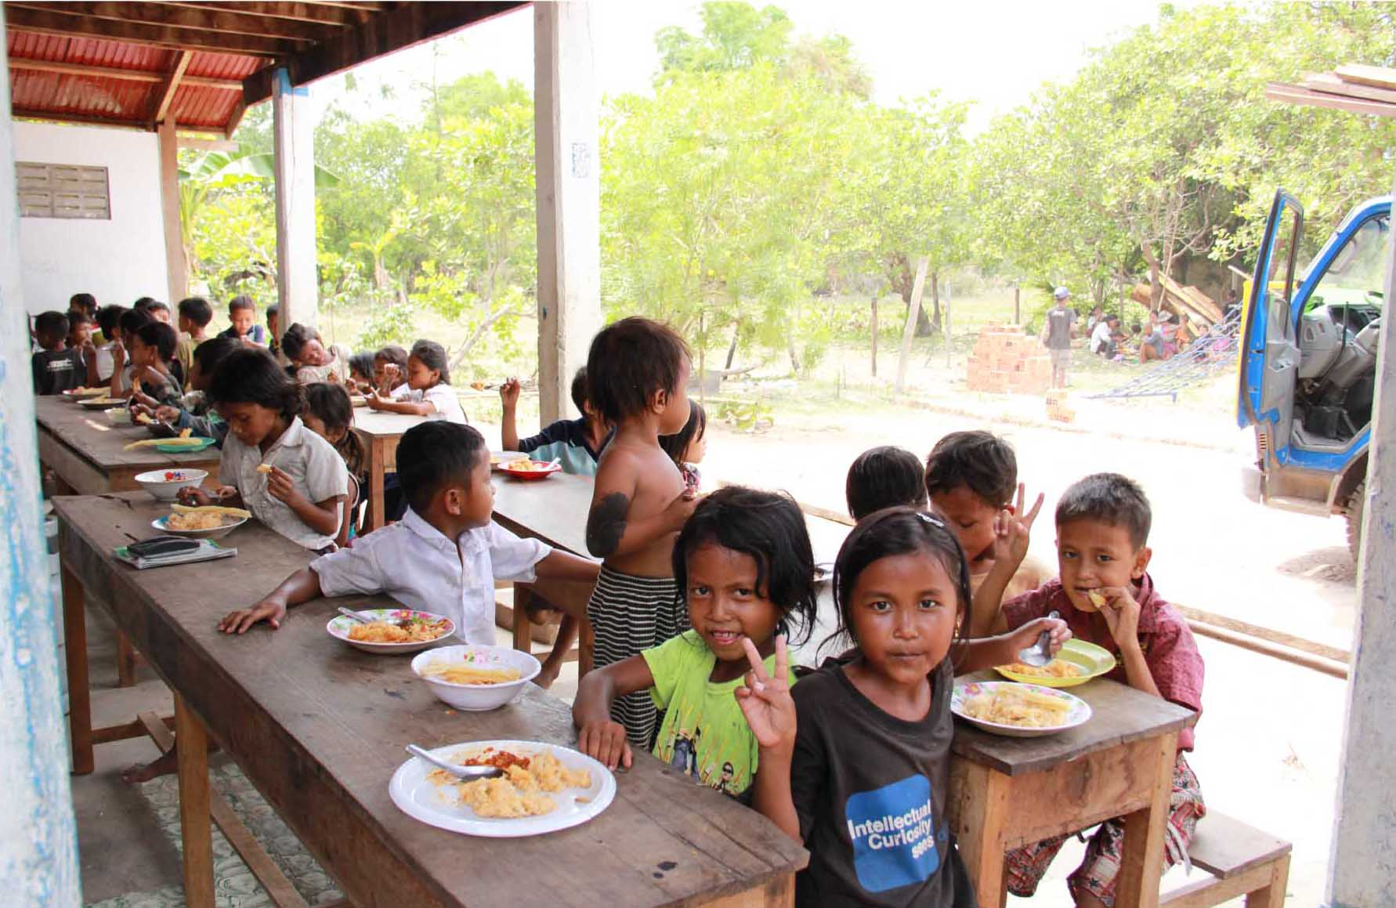
Sai Devotees from Many Countries -Cambodia Seva—A Zonal Event
22 -28 April 2014
Siem Reap, Cambodia
Over 250 villagers in the Leangdoi Commune in the Plong province of Siem Reap were served
35 volunteers from various countries in Zone 4

Slide 47
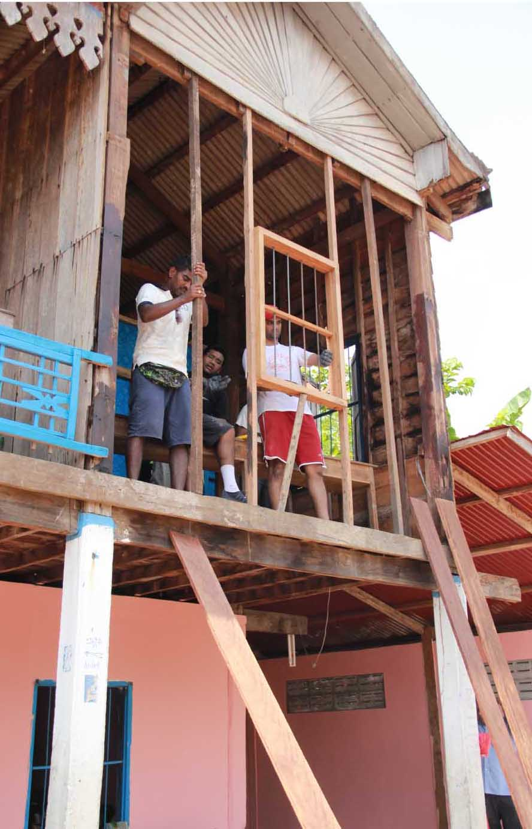
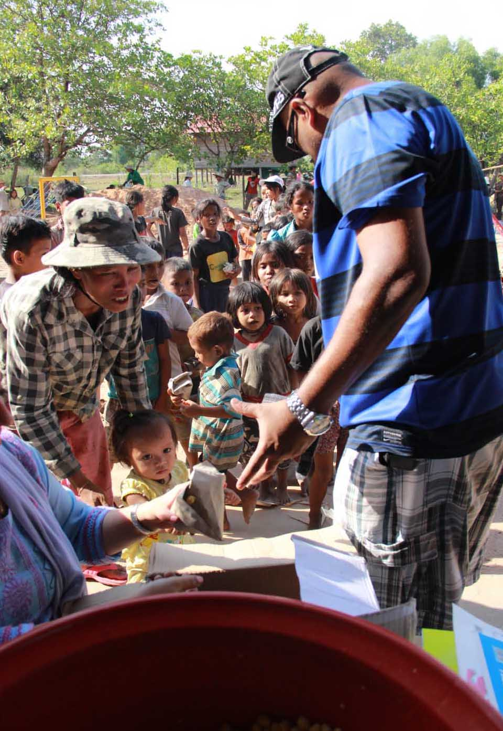
Zone 4 Grama Seva
Activities included construction of library, playground installation of solar lights, new toilet, mass cooking for 300 villagers

Slide 48
Thank you
Om Sri Sai Ram

