Slide 1
Sathya Sai School Building Project
451 Ellesmere Road, Toronto
Ontario, M1R 4E5, Canada
An offering at the
Divine Lotus Feet of
Bhagawan Sri Sathya Sai Baba

Slide 2
General Information
Date of Purchase: Jan 31 2013
24,000 Sq. ft on 2.5 Acres
New extension of 6,000 Sq. ft
Construction Began: Oct 2013
Completion Date: Sept 26 2014

Slide 3
General Information Cont’d
Facility includes:
  10 Classrooms
  Science Room
  Music Room
  Library
  Gym / Multipurpose Room
  Reception
  Principal office
  Trustees / Conference Room
  Mezzanine with 2 Extra Classrooms

Slide 4
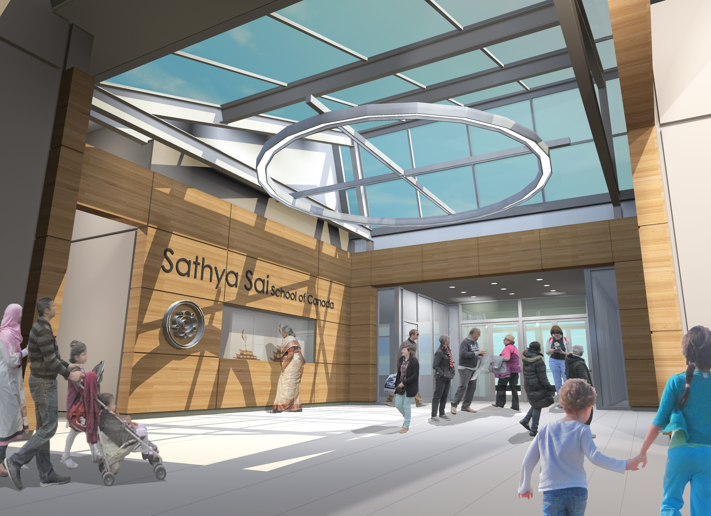

Slide 5
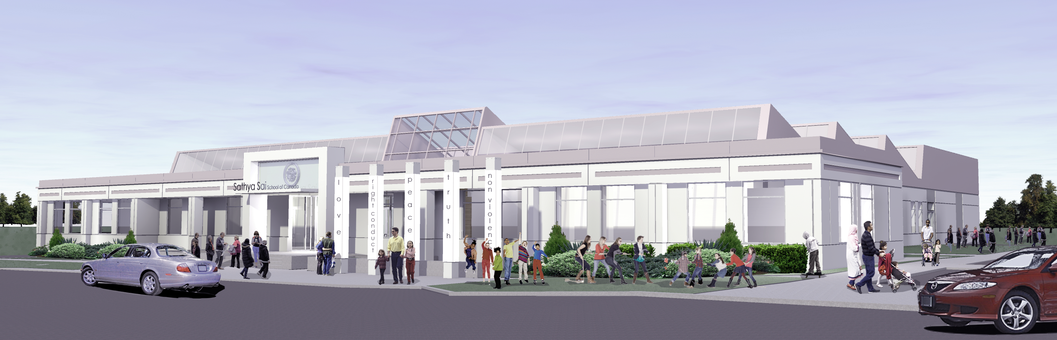

Slide 6
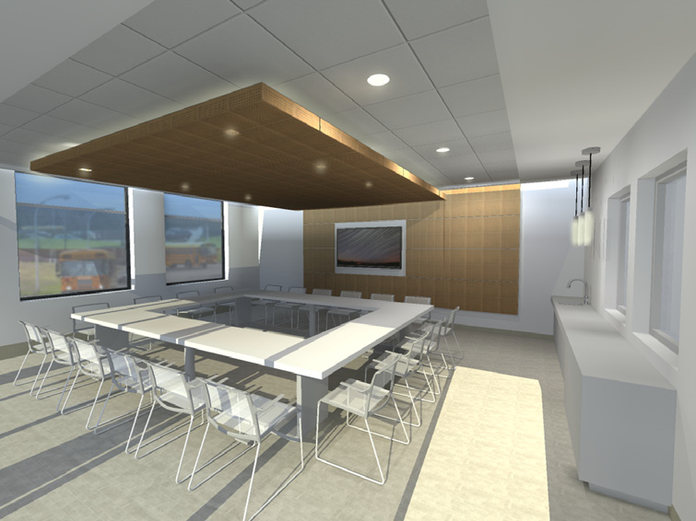

Slide 7
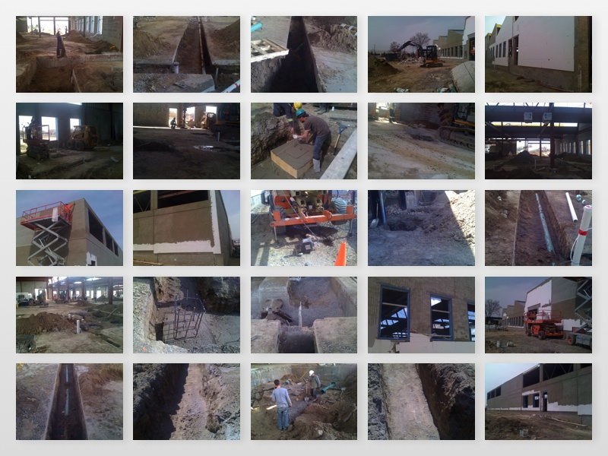

Slide 8
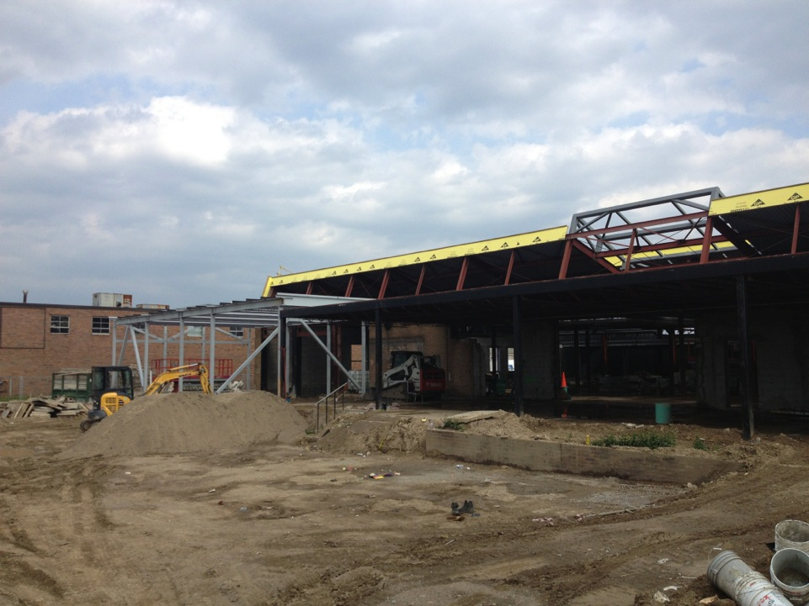
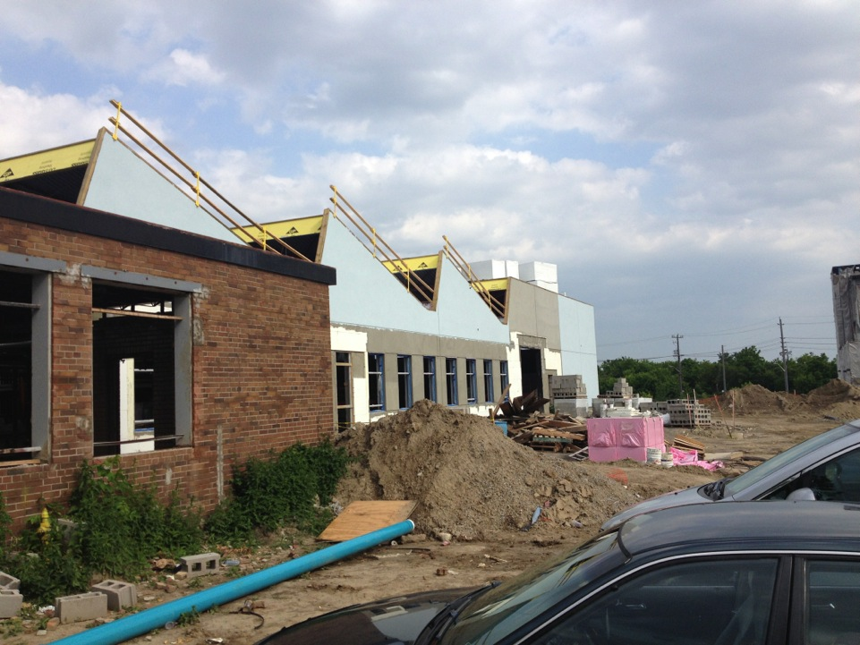
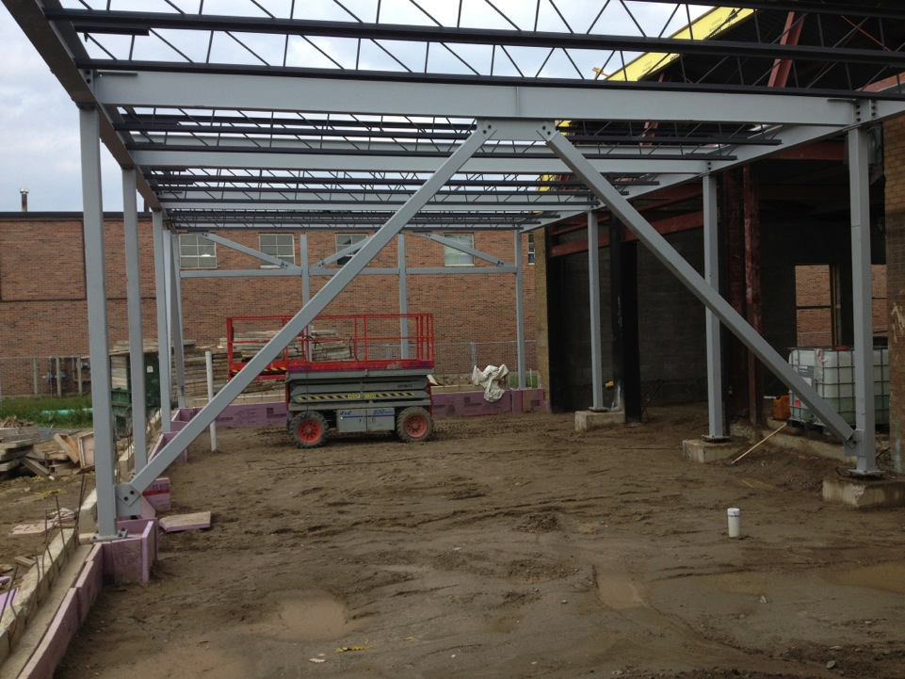
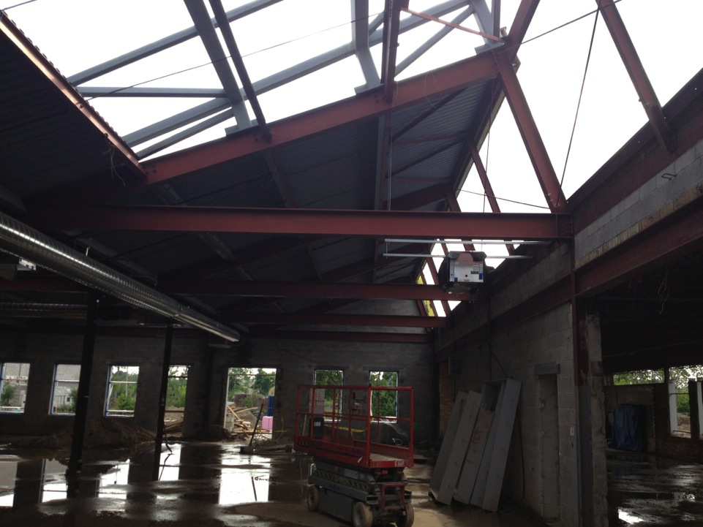
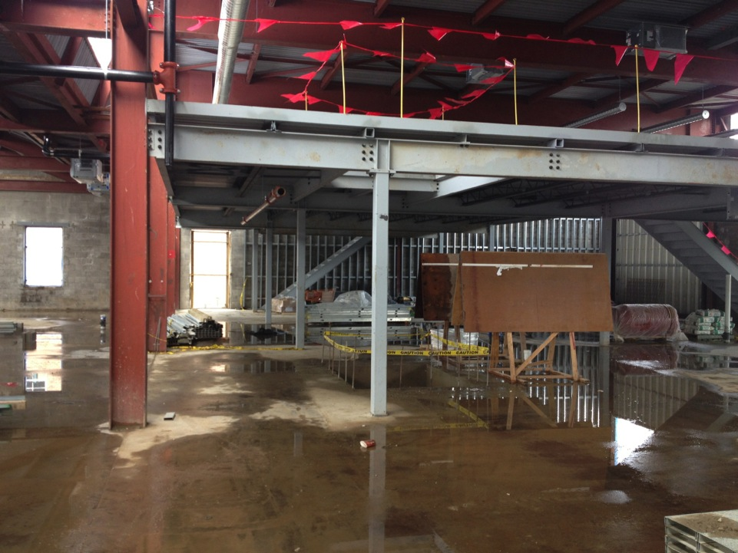
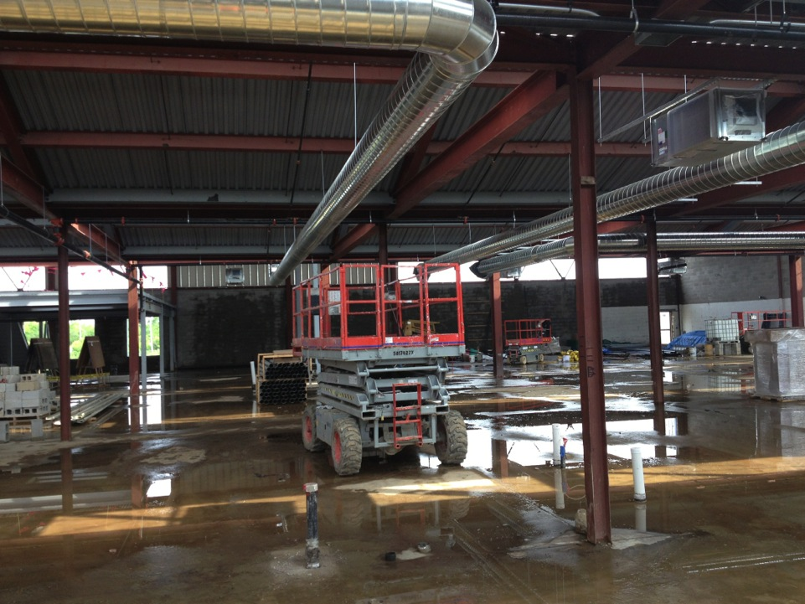
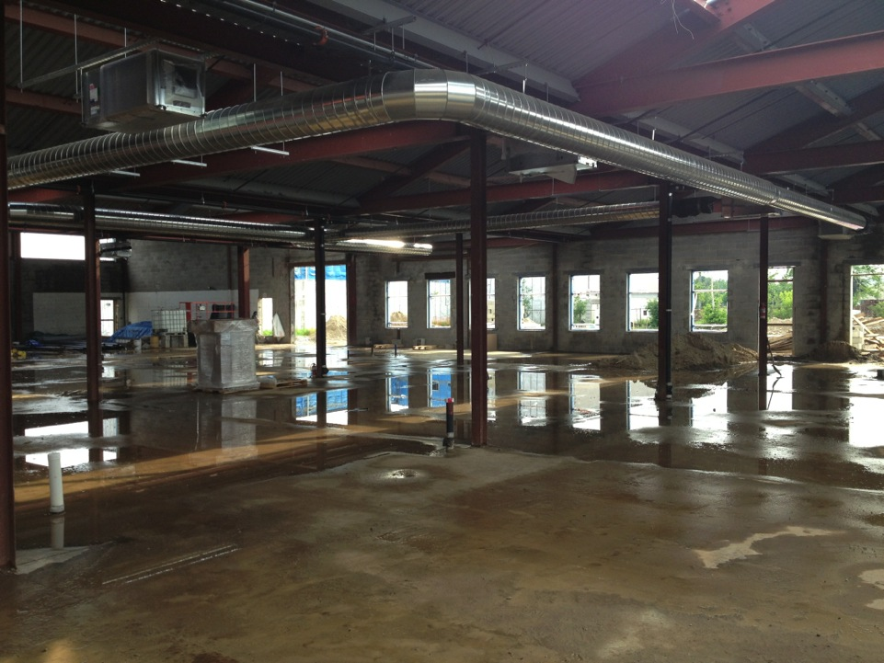
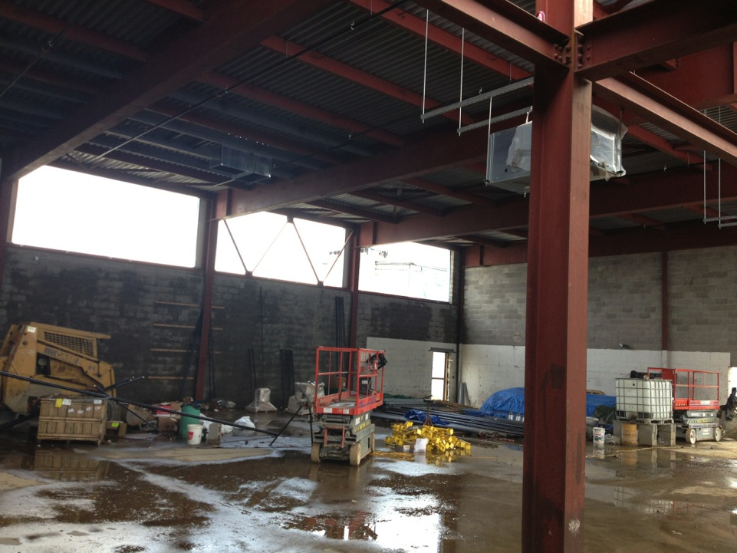
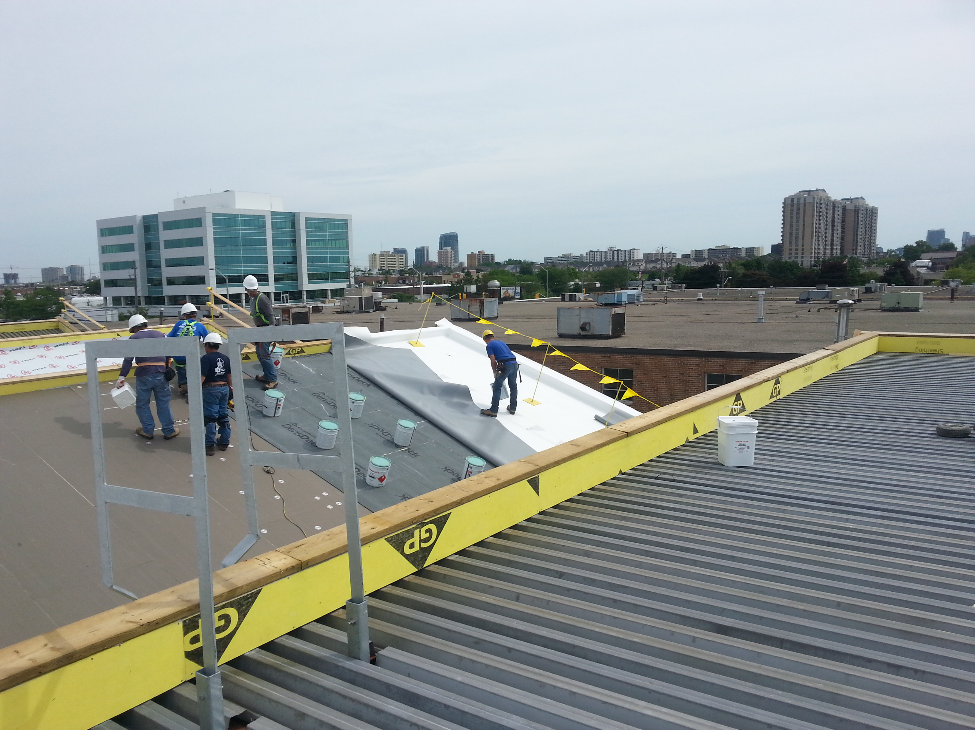
Building Project Update

Slide 9
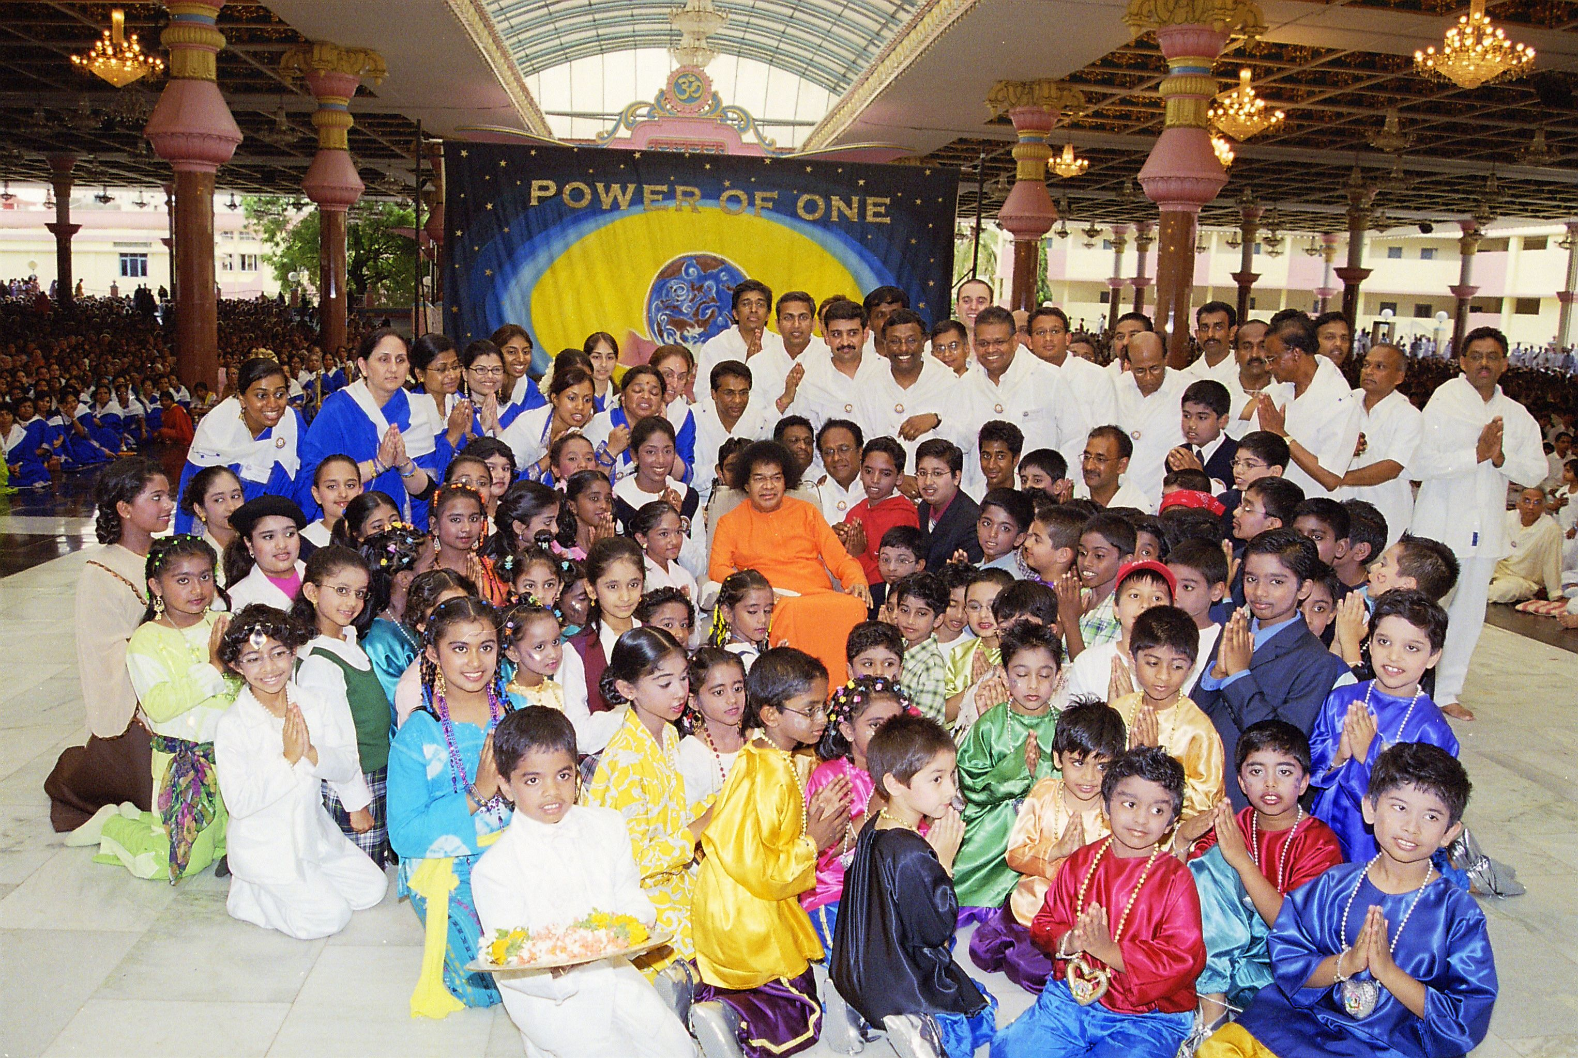
Swami blessed Sathya Sai School Children – July 2006

Slide 10
Thank you Dear Swami
The devotees of Canada offer their Love and Gratitude for gifting us with
The Sathya Sai School of Canada.
We love you Swami.

Slide 11
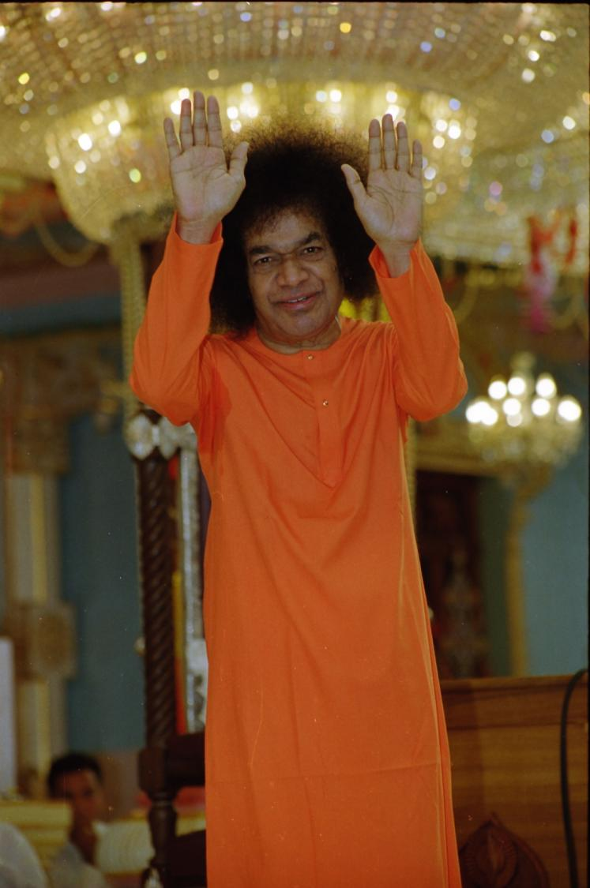

SAI Event Recap

Slide 12

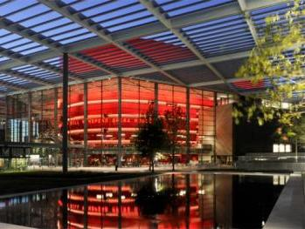
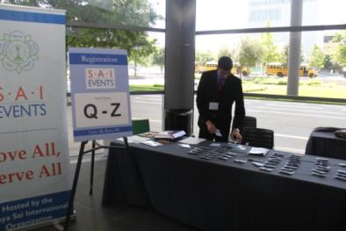
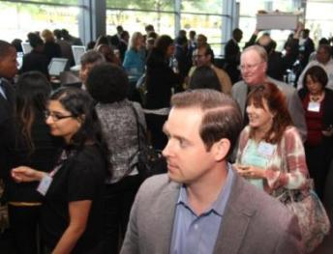
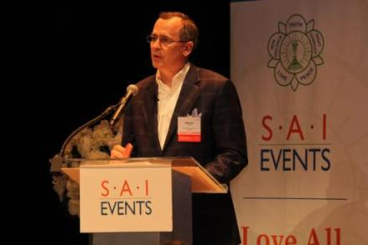
SAI Event: Loving All and Serving All
SAI = Service Awareness Integration
ABOUT THE EVENT
Region 10 held Community Action Conference in Dallas with 300 leaders from 70+ socially-minded organizations
Brought together CEOs, executive directors, & dignitaries to highlight the impact of human values in society
Event format included TED-like talks plus commitments to action on Educare, Healthcare, & Sociocare

Slide 13
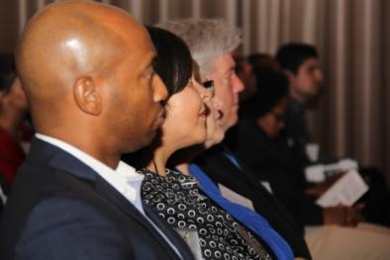
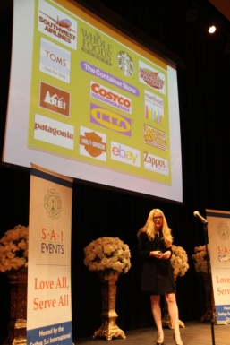
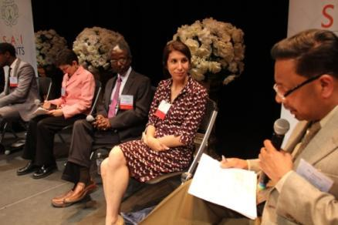
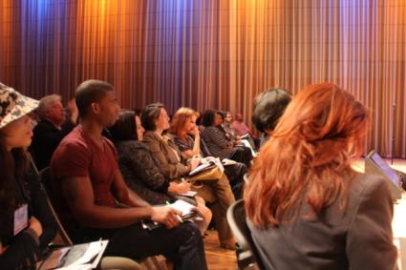
Event Provided an Opportunity to Learn, Network, & Make an Impact
OUTCOMES
SSIO Outcomes
Grew awareness about Swami’s message and SSIO activities among key community leaders
Identified Community Outreach approach and how to share Swami’s message with Community
Community Outcomes
Opportunities for other events and broader service initiatives
SAI Event Recap Video: http://m.youtube.com/watch?v=rOmbVUo-6pw

Slide 14
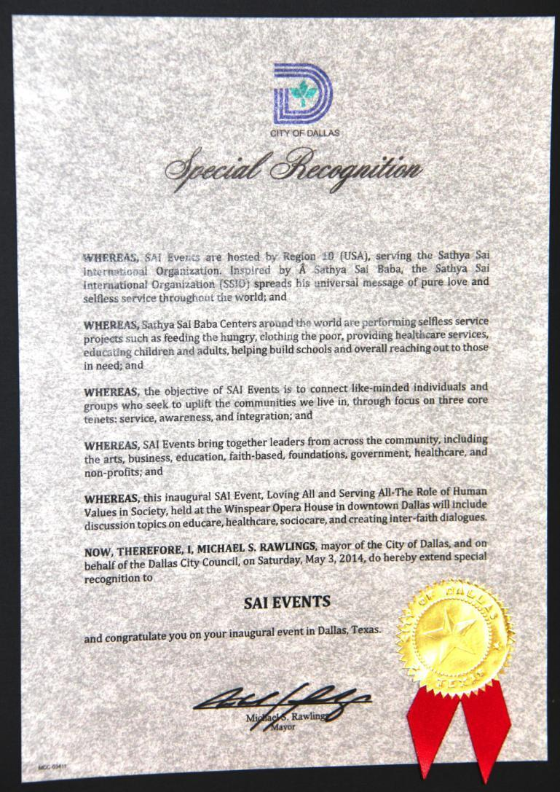
The Deputy Mayor of the City of Dallas, during her opening remarks, provided the SSIO with a Special Recognition prepared by Dallas Mayor Mike Rawlings for the Event
Notes:
Recognition

Slide 15
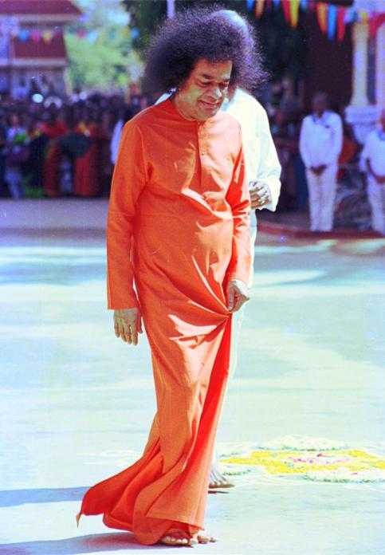
Additional Information

Slide 16
The SAI Event Planning Approach
PLANNING
ENGAGING
SHARING
CREATING
Established a Regional Community Outreach Committee
Created Dallas team to develop community relationships
Invited 300+ organizations through one-to-one conversations
Documenting Event learnings and future plans
Committee Objectives
Identify areas of opportunity for interaction with community
Develop consistent approach for sharing Swami’s Message
What We Did
Learned about key community issues around educare, healthcare, and sociocare
Met with community leaders and organizations
How We Did It
Communicated to established organizations
Setup meetings to discuss Event objectives and provide formal invitations
Activities
Capturing best practices
Conceptualizing community engagement models
Service, Cultural, Symposiums, etc.

Slide 17
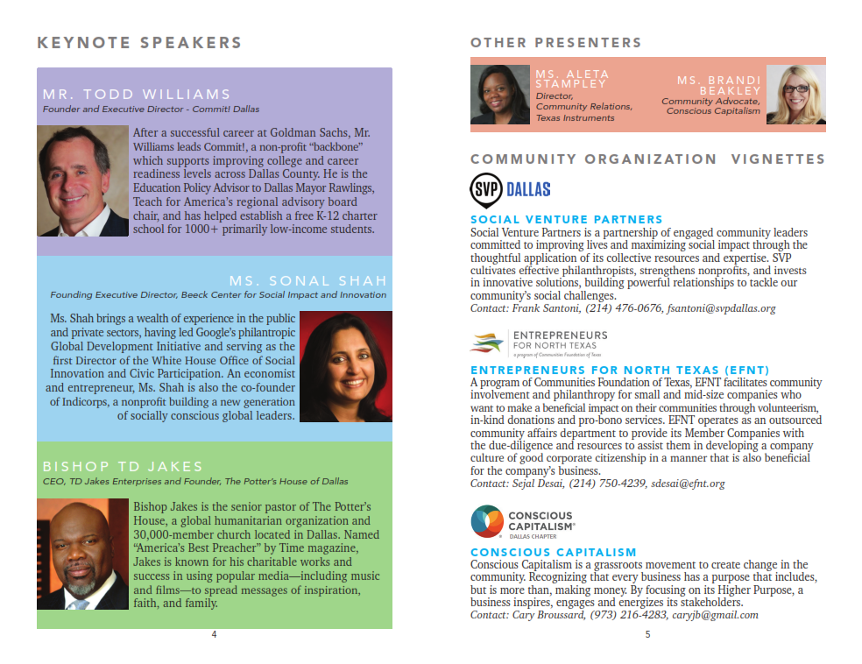
Some of our Guests…

Slide 18
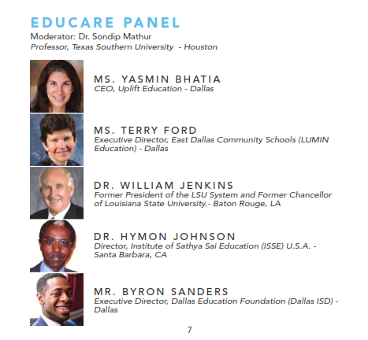
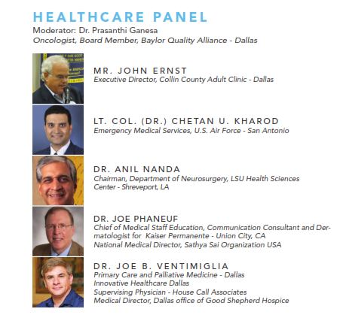
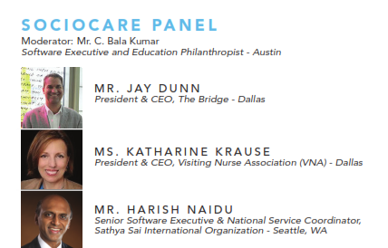
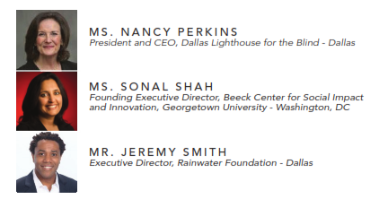

Slide 19
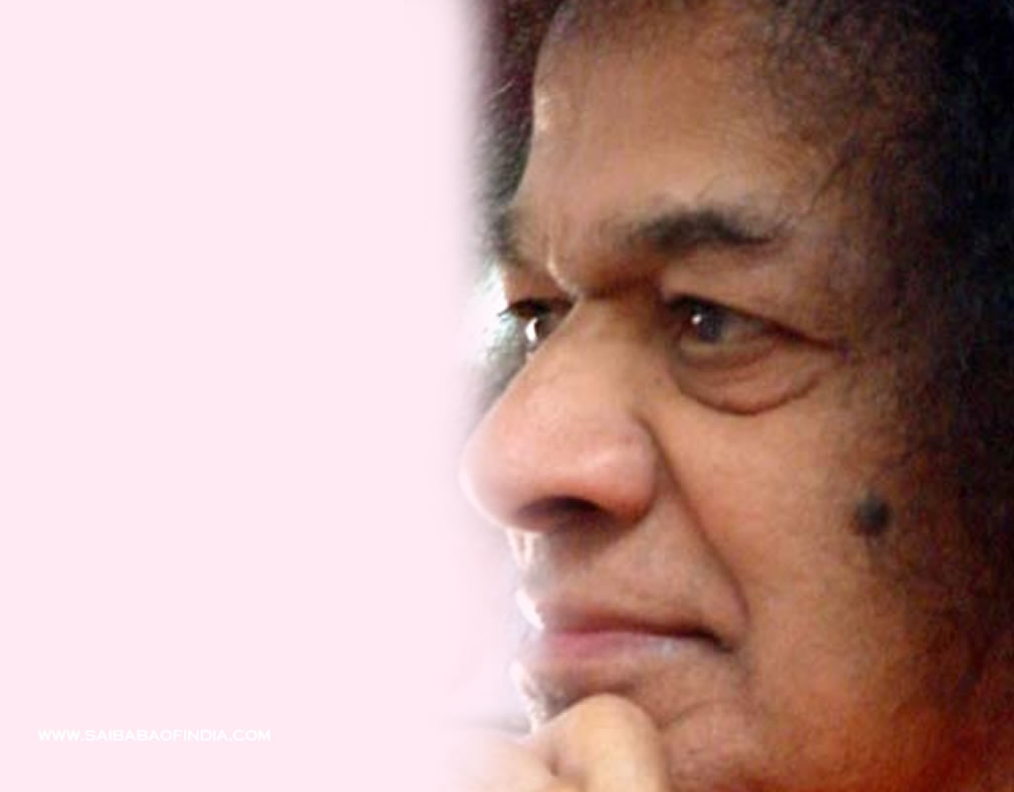
Sathya Sai West Indies
Organization
Aruba, Barbados, Curacao,
Jamaica, St Kitts, St Lucia, Suriname, Trinidad & Tobago

Slide 20
Guyana Fibroid Medical Service
President of Guyana, Donald Ramotar attended the Guyana Divine Showers 2012
He suggested service for fibroid surgeries
2 USA medical teams came Nov 8 to 23, 2013
Performed 52 surgeries, all successful
Notes:
Perhaps we can introduce ourselves and how we came to be part of this programme as we go over the history of the programme? DESCRIBING OUR ROLES WOULD BE BEST AND BRIEF DESCRIPTION OF PAST EXPERIENCE IN SAI ORGANIZATION OR WORK THAT MIGHT BE HELPFUL FOR THEM TO KNOW
I will mention that to our knowledge only UK and Europe have a leadership programme (and Australia has a apprenticeship programme) whilst other countries are thinking about developing one.
I will mention that the first phase of this programme is solely focused on youth leadership with all Zone/Dep Zone YC participating and the reasons for this

Slide 21
Guyana Fibroid Medical Service
Patients had been waiting 4-7 years
Many had large complicated conditions
Many surgeries lasted over 3 hours
President of Guyana, Donald Ramatour attended the Guyana Divine Showers 2012
He suggested service for fibroid surgeries
2 USA medical teams came 11/8-23/13
Performed 52 surgeries, all successful
President of Guyana, Donald Ramatour attended the Guyana Divine Showers 2012
He suggested service for fibroid surgeries
2 USA medical teams came 11/8-23/13
Performed 52 surgeries, all successful
Notes:
Perhaps we can introduce ourselves and how we came to be part of this programme as we go over the history of the programme? DESCRIBING OUR ROLES WOULD BE BEST AND BRIEF DESCRIPTION OF PAST EXPERIENCE IN SAI ORGANIZATION OR WORK THAT MIGHT BE HELPFUL FOR THEM TO KNOW
I will mention that to our knowledge only UK and Europe have a leadership programme (and Australia has a apprenticeship programme) whilst other countries are thinking about developing one.
I will mention that the first phase of this programme is solely focused on youth leadership with all Zone/Dep Zone YC participating and the reasons for this

Slide 22
Guyana Youth Detention Center
A government program, New Opportunity Corps, located in a remote site
Can only be reached by boat
First EHV workshop presented October 12, 2013
Youth are receptive and participate fully
5 further workshops have been given

Slide 23
Trinidad Pediatric
Cardiology Service
Shortage of Pediatric cardiologists in Trinidad
Many children suffer from correctable cardiac conditions
114 children screened, 24 complex cardiac procedure completed from April 2 to 9, 2014

Slide 24
Trinidad Pediatric
Cardiology Service
4 doctors and 4 support staff from USA assisted by 3 doctors and 1 nurse from Venezuela
Local authorities thanked SSIMC in a full page announcement in a local paper
Miracle in last minute scheduling

Slide 25
Miracle House Building Project
Continues, roughly 30 houses built in Trinidad in the past year
NOW houses have been built in Curacao and Guyana
Amazing built time frame
Sathya Sai International Leadership Programme
Notes:
The Do part is all about how this self reflection and self audit helps us as leaders to focus on our own self improvement. And the best way we can lead is to Put Swami’s teachings into practice each and every moment so that we lead by example.

Slide 26
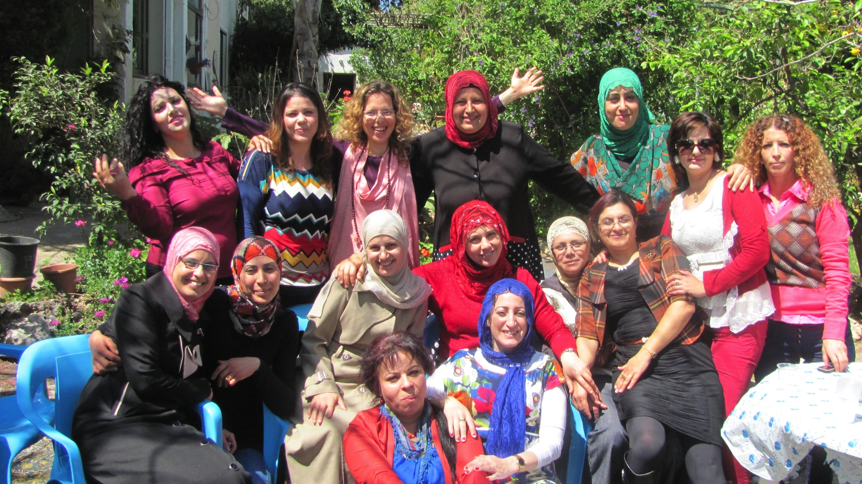
Israel EHV Arabs and Jews

Slide 27
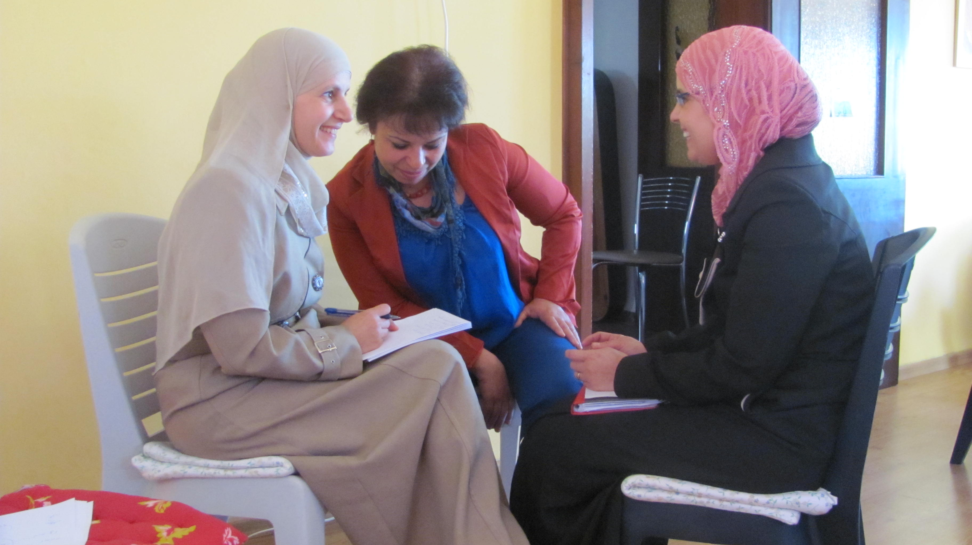
Ms Ronit Lev, head of Israel EHV program

Slide 28
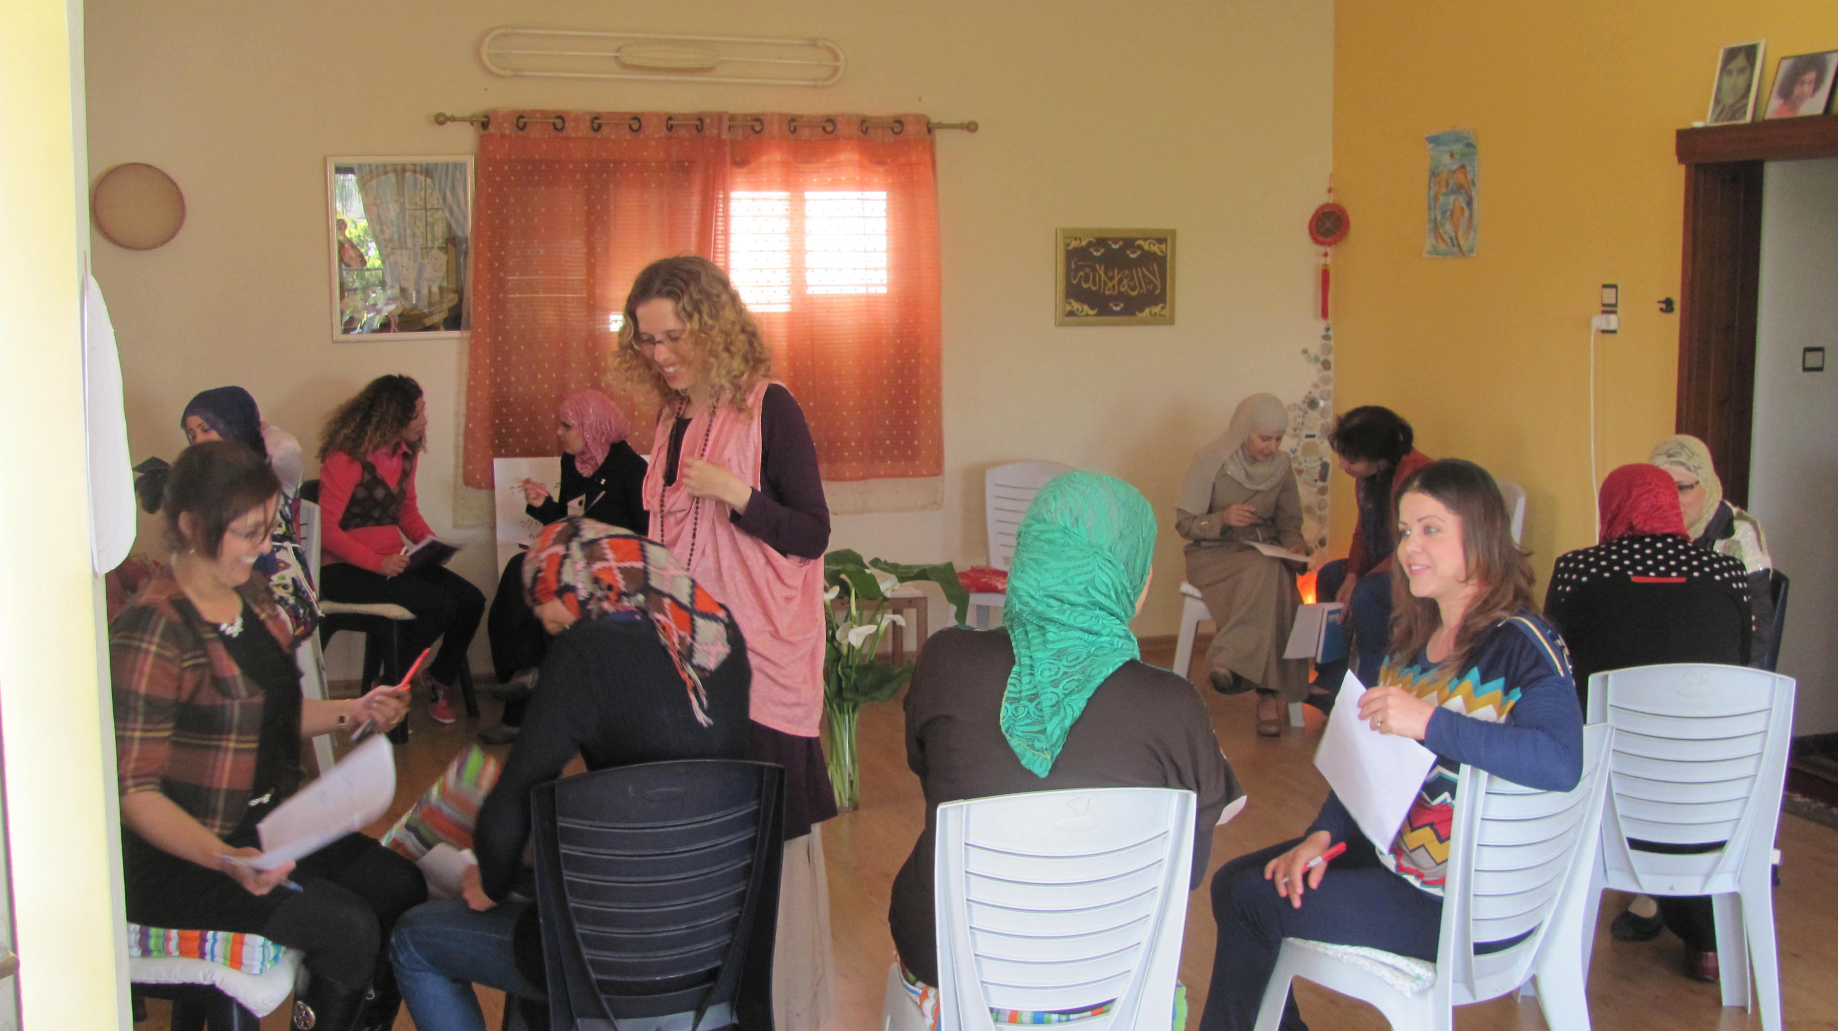
has presented EHV workshops to Arabs and Jews together

Slide 29
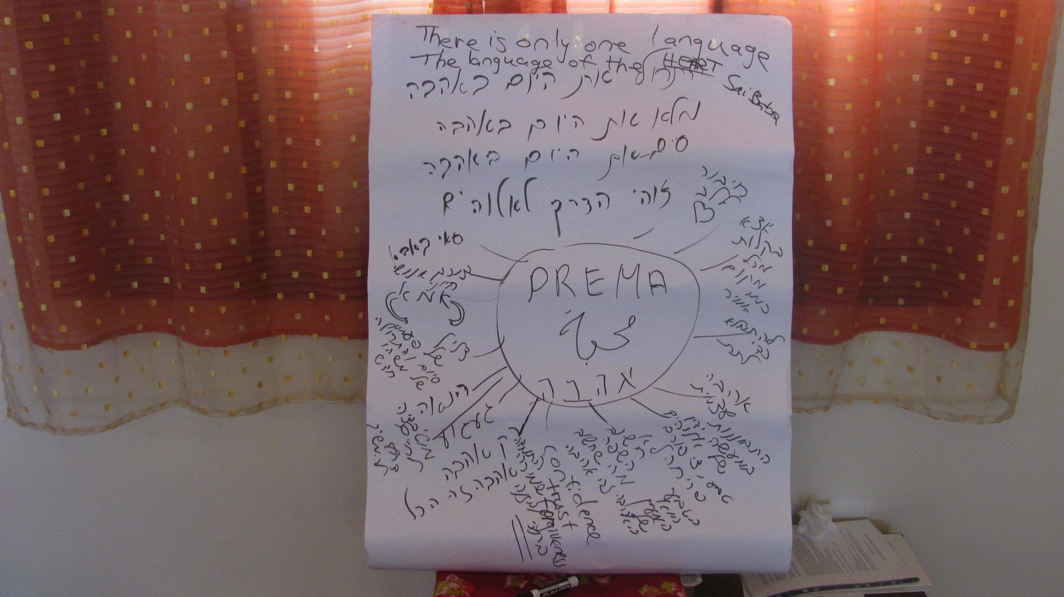
Prema (Love) in Any Language

