Slide 1
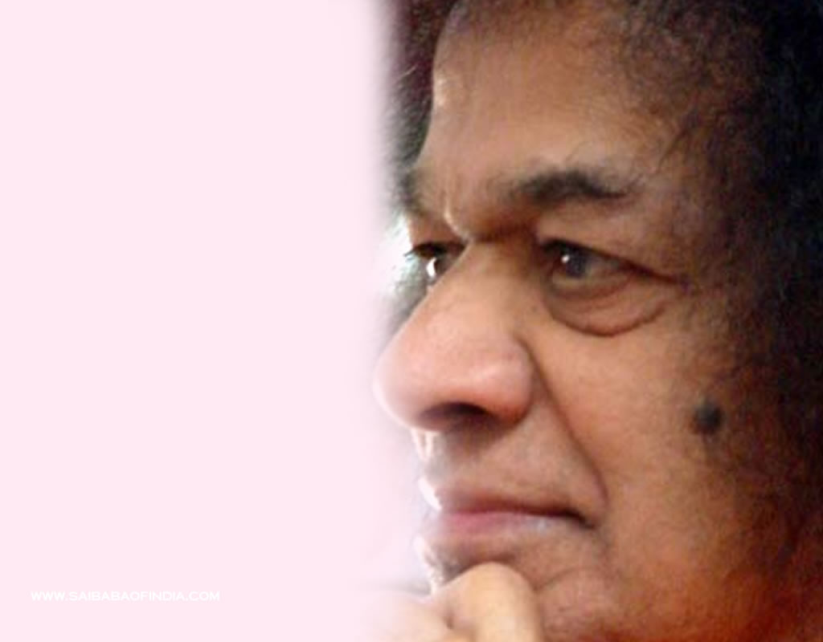
International Sathya Sai Youth Council
International Youth Coordinators Report
July 2014
Shivendra Kumar
10 July 2014

Slide 2
Sathya Sai International Youth Council Activities Report Nov 2013 - July 2014
Completion of the Serve the Planet 2013 Project
Distribution of the final report
Commencement of the Serve the Planet 2014 Project
Theme: Children our future
Information presentation to Prashanti Council
Project ideas and milestones communicated

Slide 3
Sathya Sai International Youth Council Activities Report Nov 2013 - July 2014
Sathya Sai International Youth Festival Survey
Feedback received from 1000+ Youth
Provided an understanding of expectations of the festival
Festival confirmed for July 2016, before Guru Poornima
Allows youth to be part of the World Conference in 2015
Planning commenced.

Slide 4
Sathya Sai International Youth Council Activities Report Nov 2013 - July 2014
Sathya Sai International Leadership Program
Proposal document developed and approved
Presented to Prashanti Council
9 modules -5 online and 4 residential
Modules focus on the Sathya Sai Organization and Leadership Skills development
Team actively working towards a November 2014 completion.

Slide 5
Sathya Sai International Youth Council Activities Report Nov 2013 - July 2014
Telephone Discussion with Zone Youth Coordinators – Feb/ March and May/ June
Pre-World Conferences and Zone Youth Conferences
Study Circle Guides for Pre-World Conference to be used by Youth
Sai Universe Website – Promotion
Serve the Planet 2014 Details
International Youth Festival Update
International Leadership Program Update

Slide 6
Sathya Sai International Youth Council
Om Sai Ram
Shivendra Kumar
kumar.shivend@gmail.com

