Slide 1
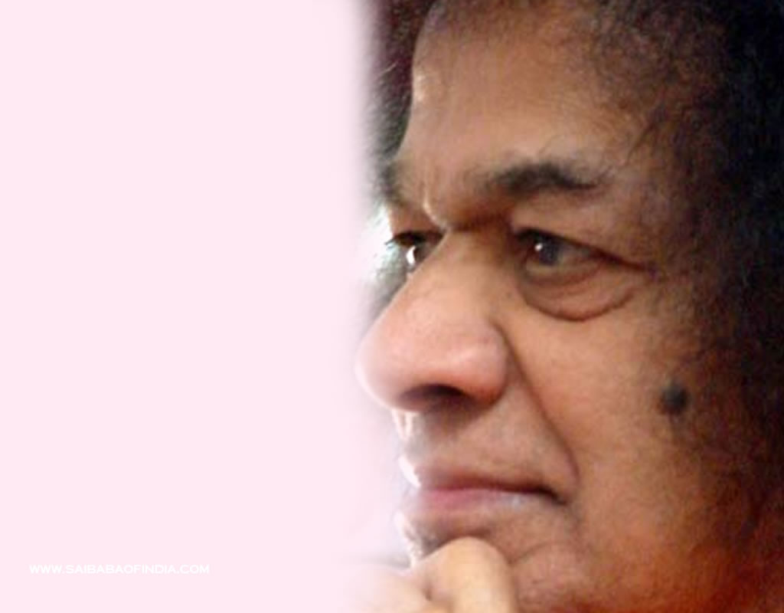
Sathya Sai International Youth Council
Special Presentation for the Prashanti Council, Sri Sathya Sai World Foundation and Zone Chairs
Shivendra Kumar
9 July 2014

Slide 2
Sathya Sai International Youth Council Special Presentation – July 2014
Sathya Sai International Leadership Program
Deviesh Tankaria and Dr. Joe Phaneuf
Serve the Planet 2014 – Children Our Future
Shivendra Kumar and Alida Parkes
Sathya Sai International Youth Festival
Shivendra Kumar
Q& A

Slide 3
Leadership: The History
Sathya Sai World Youth Conference 1997
History of Sai Leadership programs
Notes:
Perhaps we can introduce ourselves and how we came to be part of this programme as we go over the history of the programme? DESCRIBING OUR ROLES WOULD BE BEST AND BRIEF DESCRIPTION OF PAST EXPERIENCE IN SAI ORGANIZATION OR WORK THAT MIGHT BE HELPFUL FOR THEM TO KNOW
I will mention that to our knowledge only UK and Europe have a leadership programme (and Australia has a apprenticeship programme) whilst other countries are thinking about developing one.
I will mention that the first phase of this programme is solely focused on youth leadership with all Zone/Dep Zone YC participating and the reasons for this

Slide 4
The future of the world rests in the hands of the youth
“The future of the country depends on the skill and the sincerity of the youth. Therefore, the necessary enthusiasm and encouragement must be generated among the youth. All my hopes are based on the students, the youth. They are very dear to me” Sathya Sai Speaks IX (old edition), 34, 184.
Sathya Sai International Leadership Programme

Slide 5
The foundations of the SSILP: Bhagawan’s life and teachings
Bhagawan Sri Sathya Sai Baba and His Mahavakya on Leadership: BE, DO, TELL
The importance of character and leading by example
Those participating in this Programme are the torch bearers and ambassadors of the Divine mission
Sathya Sai International Leadership Programme

Slide 6
Timeline for the Sathya Sai International Leadership Programme (SSILP)
Proposal document for the programme
Programme to be offered at Bhagawan’s Lotus Feet on the 23rd November 2014
This pilot programme will commence January 2015 until November 2015
Participants to graduate from the SSILP during the Sathya Sai World Conference in Prashanti Nilayam in November 2015
Sathya Sai International Leadership Programme

Slide 7
Modules and delivery of the SSILP
Sathya Sai International Leadership Programme
Notes:
Hand off Deviesh to Dr. Joe

Slide 8
SSILP Module 1 Swami’s Life and Message Mr. Chandrasekhar Balivada
Swami’s Life and Message and reason for establishing the Sathya Sai International Org.
“The main objective of the Sathya Sai Organisation … is to help humanity recognize and manifest it’s inherent divinity”
“You should consider the Organisation as your life breath”
Sathya Sai International Leadership Programme
Notes:
LEAD Mr. Chandrasekhar Balivada from Australia
We as leaders, are really chief servants of everyone in the organization, and we have a sacred duty to serve to the best of our ability with love, humility, and total dedication, and remember how Leadership in this organization is linked to spirituality.

Slide 9
SSILP Module 2 Organisation Guidelines Mr. Shivendra Kumar
International Permanent Charter (1981)
International Guidelines for Centres and Groups (2012)
Operations Manual for Centres and Groups
Key Discourses to Youth and Resolutions for WYC 1997, 1999, 2007
Sathya Sai International Leadership Programme
Notes:
Lead Shivendra Kumaf
The charter and guidelines form the basic foundation of the governance and the operation of the SSIO
Swami’s discourse to the Youth over the years, especially the discourses of all the WYC’s as well as the resolutions that came out of each WYC also help guide all of us in regards to our individual spiritual transformation as well as how we function as a YA program and its also the basis developing future leaders for the organization and the world.

Slide 10
SSILP Module 3 Organisation Guidelines Mr. Shivendra Kumar
Rules and Regulations in the Charter and Organizational guidelines that govern financial decisions.
How finances are managed and accounted for in our local environment
Role of risk management in the SSIO and identify key risks
Sathya Sai International Leadership Programme

Slide 11
SSILP Modules 4 & 5 Mahavakya on Leadership Mr. Severin Trifunovic (DCC7) Mr. Kevin Sheehan
BE – daily reflection with diary
Unique opportunity for personal self reflection and spiritual transformation
DO – Putting Swami’s teaching into practice
Leading by example
Sathya Sai International Leadership Programme
Notes:
The Do part is all about how this self reflection and self audit helps us as leaders to focus on our own self improvement. And the best way we can lead is to Put Swami’s teachings into practice each and every moment so that we lead by example.

Slide 12
SSILP Modules 6 Communication Dr. Joe Phaneuf
Challenging Conversations – “First understanding, then adjustment” “If you cannot oblige, speak obligingly”
Email etiquette
Leading meetings
Engaging with public
Sathya Sai International Leadership Programme
Notes:
Dr. Joe Phaneuf modules lead.
Swami has given us so much good advice on loving communication such as … and how practical and useful these teaching are in leadership not to mention every other situation at work, home, school, and every other situation where we communicate with others.
We will also cover what does loving and respectful communication look like when we email others and also when we lead meetings.
Finally how can we communicate with others outside of our organization in a meaning way (public meetings to share teachings of Swami, walk for human values, EHV efforts, working with and learning from other organizations that have similar goals and do similar service in our local communities.

Slide 13
SSILP Modules 7 Team Dynamics Ms. Aparna Murali
How to build an effective and dynamic team
How to manage a team
How to sustain a team
How all of these team dynamics present unique challenges in a spiritual all volunteer organization
Sathya Sai International Leadership Programme
Notes:
Aparna Murali module lead
How to build that is effective, dynamic and most importantly the team works together with unity, harmony and love
How to manage a team
How to sustain with positive energy and enthusiasm

Slide 14
SSILP Modules 8 Project Management Mr. Saurabh Saksena
Project management processes including Initiation, Planning, Implementation, Monitoring, Quality Control and Evaluation
Project management concepts such as stakeholder communication, change management, team building and reporting.
Sathya Sai International Leadership Programme
Notes:
Module lead Mr. Saurabh Saksena (Oman)
Fortunately Swami has given much guidance in all of these areas to his MBA students over the years. Mr Saurabh Saksena who is the module lead will discuss Swami’s guidance to all His MBA students and add the special guidance Swami has given to him personally on project management .

Slide 15
SSILP Modules 9 Youth Challenges Mr. Alvin Leo (former ZYC3)
Special challenges over this wide age range (18-35)
Swami’s aspiration for Youth
Swami’s guidance to face all of life’s challenges and develop into ideal Sai Youth
Sathya Sai International Leadership Programme
Notes:
For Youth Challenges The seventeen years spent as a Sai youth are dedicated to fostering spiritual maturity. There are, however, growing pains to address as youth undergo many changes in their life stages between 18 and 35 years old. Depending on how it is presented, these life changes can be challenges or opportunities; either way they are still issues that are very real to our youth populace who are citizens of the world. In completing this module, office bearers will appreciate the concerns facing this cohort of members, develop responses that will be correctly contextualised to meet the needs of this emerging pool of future leaders, know the aspirations Swami has for the youth, and what guidance He gives to develop ideal Sai youth.

Slide 16
Programme Design
Modules 1-5, and 9 offered online
5 day residential modes for 6-8 in Prasanthi Nilayam during Gurupoornima 2-15
Day 1: Review of Module 1-5
Day 2: Module 6 - Communication
Day 3: Module 7 - Group Dynamics
Day 4: Module 8 - Project Management
Day 5: Putting it all together and course evaluation
Sathya Sai International Leadership Programme
Notes:
Day one will be a review and time to test competencies for first 5 modules
Modules 6-8 will each have one full day to introduce and work thru these modules with interactive workshops, break out sessions, and other group exercises to help bring out each person’s inner wisdom. We basically will be using Swami’s educare method of education.

Slide 17
SSILP Committee
Mr. Deviesh Tankaria (UK) SSILP Chair, Zone 9A Deputy Youth Coordinator
Mr. Shivendra Kumar (AUS) International Youth Coordinator
Mr. Alvin Leo (AUS) Former Zone 3 Youth Coordinator
Dr. Joe Phaneuf (USA) National Youth Advisor
Ms. Aparna Murali (USA) National Youth Advisor
Sathya Sai International Leadership Programme
Notes:
We are open to suggestions from you from any part of the world and in particular from from some under represented areas such as Asia, Latin America and Africa. If you have names of youth from your region who may be able to contribute, please contact Dr Reddy, Shivendra, Deviesh or myself. Based on your recommendations and their experience we will interview some of these candidates and consider adding the to our committee or use them as consultants for further module development.
Thanks for your time and attention, we will take questions at the end.

Slide 18
Questions
Sathya Sai International Leadership Programme

Slide 19
Sathya Sai International Youth Council Serve the Planet 2014
“Children Our Future”
2014
Serve the Planet Leadership Team:
Mr. Shivendra Kumar
Ms. Alida Parkes
Ms. Raksha Mahtani

Slide 20
Sathya Sai International Youth Council Serve the Planet 2014
“These tender hearts can be trained to grow straight and strong. They are the pillars on which the foundation of the world's future is built. It is highly important to take care of the health of children. Good health is the basis for everything else in life. Through good health and good education, you can improve the condition of the children. We have to inspire them to become 'heroes of action', whose lives are dedicated to work as worship to the one God who resides in all. So, I wish to declare that the first duty of every adult, son and daughter, is to pay loving attention to the children.” - Sathya Sai Baba (13/05/1979)

Slide 21
Sathya Sai International Youth Council Serve the Planet 2014
Service Project Suggestions:
Human Values Classes
Assist school children with School supplies, tuition & learning
Preventive health programs like health education, immunization and provision of medical supplies

Slide 22
Sathya Sai International Youth Council Serve the Planet 2014
Service Project Suggestions:
Providing nutritional food such as fruit
Provide Service at Orphanages
Encourage and support development of creativity, social skills and talent in children.

Slide 23
Sathya Sai International Youth Council Serve the Planet 2014
Milestones and Deliverables
1
2

Slide 24
Sathya Sai International Youth Council International Youth Festival
Pre-Festival Survey Results
International Youth Festival will be held in July 2016, before Guru Poornima.
Allows Youth to attend the World Conference 2015 and Prashanti Council members to attend the Youth Festival.

Slide 25
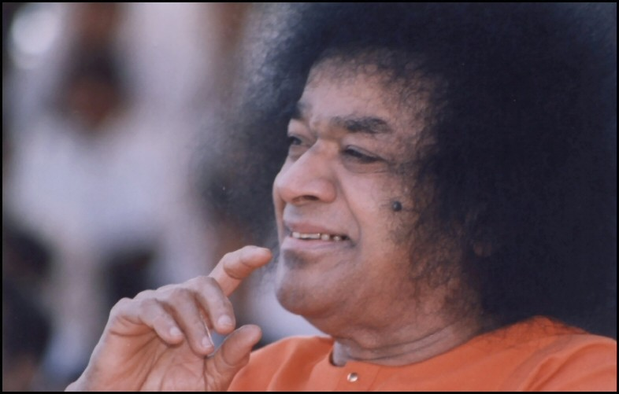
Sathya Sai International Youth Council Questions
Deviesh Tankaria – deviesh_tankaria@hotmail.com
Dr. Joe Phaneuf – joephaneuf@yahoo.com
Shivendra Kumar – kumar.shivend@gmail.com

