Slide 1
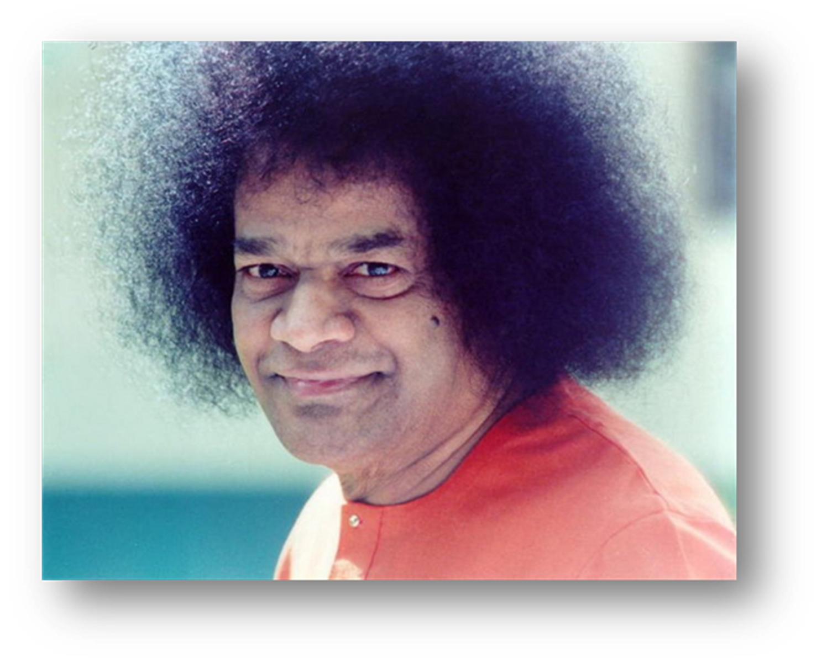
Media Coordination Committee
Guru Poornima Meetings
Prasanthi Nilayam
July 2014

Slide 2
Status Update : Mid-2014
New Media Committee formed Nov 2013
Members: Alida Parkes, Pravin Wagh, and Anupom Ganguli
Zone Media Coordinators Appointed from all 11 Zones
Web Seminars held March – April 2014
Articles, Pictures and Video Quality Improving
Two New Initiatives
Introductory Videos (3) – under preparation
Sathya Sai Universe website – Launched April 2014

Slide 3
Zone Media Coordinators
Some Zones are submitting excellent material
Media Coordinators need support by National, Regional, and Local Organisation
Senior Leaders need to implement process
Quality of articles, pictures, videos – very important
More coordination needed: internally and externally
Media Team Inbox: MediaTeam@sssio.org
Additional Web Seminars in 2nd Half of 2014

Slide 4
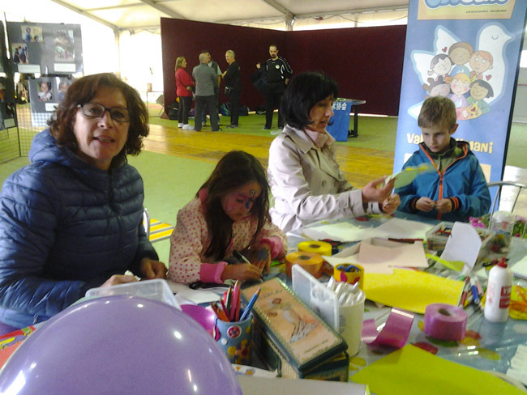
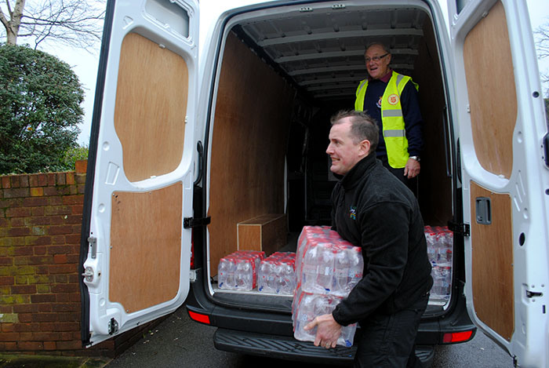
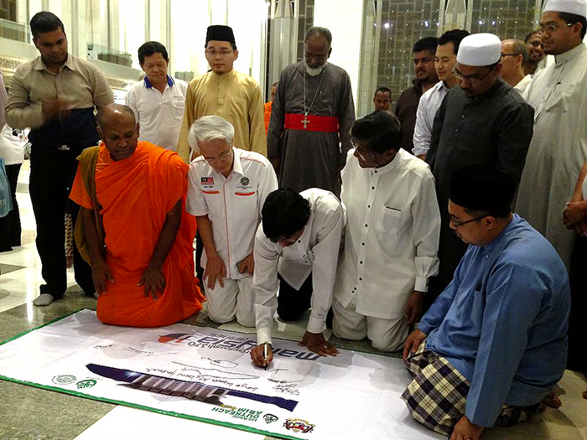
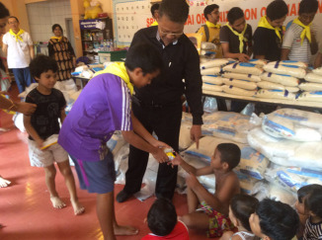
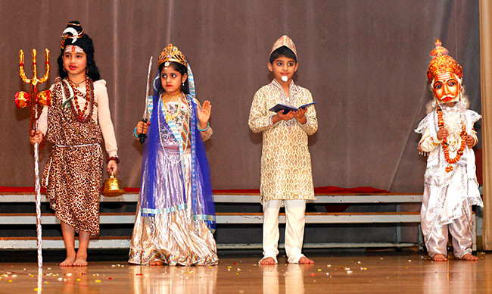
Sathya Sai Universe
New Website Inaugurated in April 2014
Articles with Pictures from All Zones
Special Features: Search; Google Translator; Links
Updated on On-Going Basis
Videos coming Next
Please visit: saiuniverse.sathyasai.org
Your Ideas ???

Slide 5
New Video Project
Producing 3 Videos to Introduce Sathya Sai Organisation
Introduction, Structure, Centres, Activities, Websites
12-min., 6-min., and 3-min. long: English
Suitable for Sathya Sai Members and Public
For use by all Zones (with subtitles, if needed)
Received video clips from S. Africa, Zambia, Hong Kong, Greece, USA,…
Voice-over being done in London, Los Angeles
To be offered to Swami during Birthday Celebrations 2014

Slide 6
2013-2014 Annual Report
Started process for Next Annual Report
April 2013 – March 2014
Zone Chairs requested to update summary of activities in each Zone
Zone Chairs requested to provide Pictures
Educational, Health Mission, and Youth Activities Reports
To be offered to Swami during Birthday Celebrations 2014

Slide 7
2013 SSIO Survey Results
Annual Survey conducted in 1st Quarter 2014
Comprehensive Data on International Organisation
All Zone data compiled by Country
Summary of Results: NEXT

Slide 9
Summary by Zone
Zone | Countries Total / Reported |  | Centers /Groups | Total Members | SSE Students | **Institutes of Sathya Sai Education | **Sathya Sai Schools | SSE Classes | SSE Teachers | Workshops Teachers/ Parents | Devotional Singing | Study Circles | Guest Meetings | *Youth Activities
1 | 13 | 12 | 351 | 22,044 | 6,115 | 3 | 1 | 5,717 | 1,369 | 200 | 12 | 9 | 6 | 4
2A | 14 | 14 | 94 | 2,034 | 264 | 4 | 3 | 737 | 59 | 14 | 13 | 12 | 9 | 4
2B | 10 | 10 | 154 | 2,849 | 234 | 4 | 11 | 350 | 127 | 60 | 10 | 10 | 6 | 9
3 | 4 | 4 | 140 | 5,205 | 1,138 | 4 | 4 | 1,917 | 275 | 53 | 4 | 4 | 4 | 4
4 | 11 | 10 | 453 | 45,271 | 18,371 | 2 | 7 | 9,042 | 1,433 | 150 | 11 | 9 | 8 | 7
5 | 5 | 4 | 38 | 1,136 | 377 | 2 | 1 | 1,064 | 53 | 57 | 4 | 3 | 2 | 3
6 | 11 | 11 | 102 | 1,744 | 238 | 1 | 0 | 483 | 94 | 44 | 11 | 11 | 7 | 11
7 | 15 | 15 | 121 | 1,514 | 99 | 1 | 0 | 148 | 92 | 36 | 15 | 14 | 4 | 9
8 | 8 | 8 | 109 | 956 | 249 | 0 | 0 | 1,271 | 158 | 86 | 8 | 8 | 8 | 7
9A | 23 | 22 | 349 | 20,869 | 4,932 | 3 | 13 | 5,514 | 749 | 197 | 22 | 16 | 9 | 13
9B | 12 | 11 | 26 | 1,882 | 1,494 | 0 | 0 | 536 | 198 | 13 | 11 | 10 | 5 | 4
Totals | 126 | 121 | 1,937 | 105,504 | 33,511 | 24 | 40 | 26,779 | 4,607 | 910 | 121 | 106 | 68 | 75

Slide 10
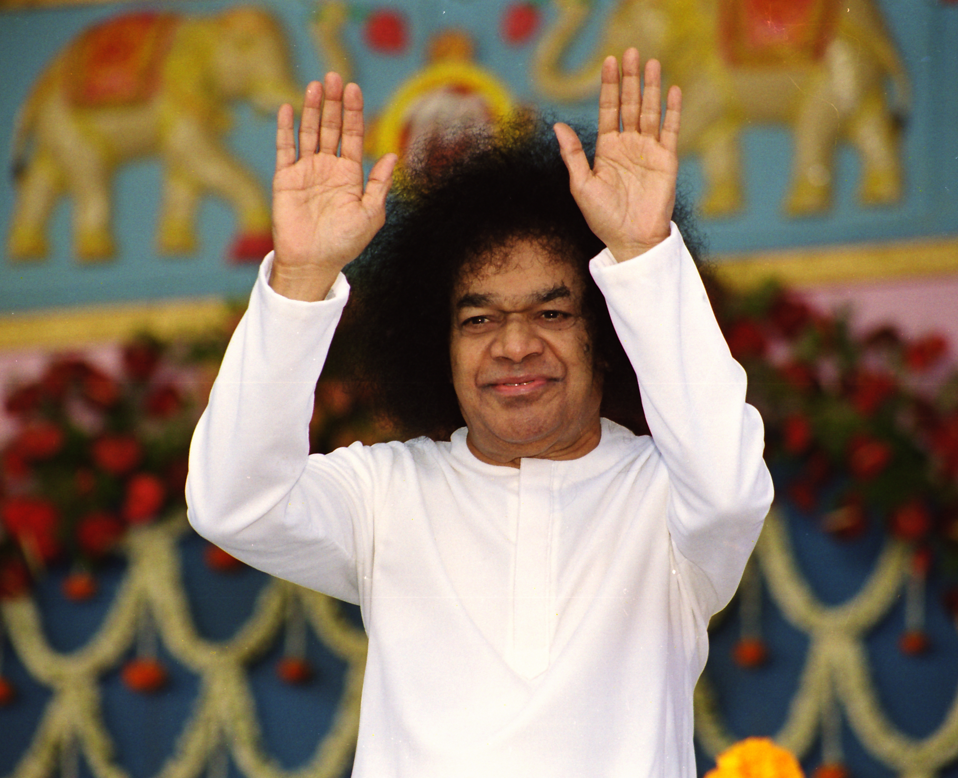
Thank You
Jai Sai Ram

